Slide 1
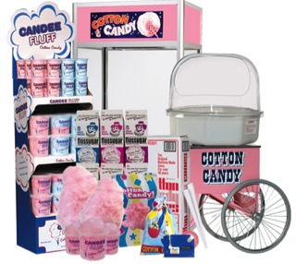

Cotton Candy

Slide 2
About M.R.S. Packaging Ltd
M.R.S. Packaging is the leader in providing high quality Fun Food Concession equipment and supplies for the entire Middle Eastern GCC Region.
We are a One Stop Supplier that offers name-brand, high quality concessions equipment and supplies to the entire Middle East, U.A.E , Dubai, Kuwait, Bahrain, Qatar, Oman, Saudi Arabia, Syria, Jordan & Lebanon.
We provide the best Concession Equipment, high quality supplies, delicious and easy-to-use Food Ingredients, and Food Service Disposable packaging options.
Our team is dedicated to making sure that you are taken care of, before and after sale. We provide you with excellent after-sales service, on-site installation of your equipment, operational training and advice on how to use and care for your machine, and a one-year warranty on the equipment.

Slide 3
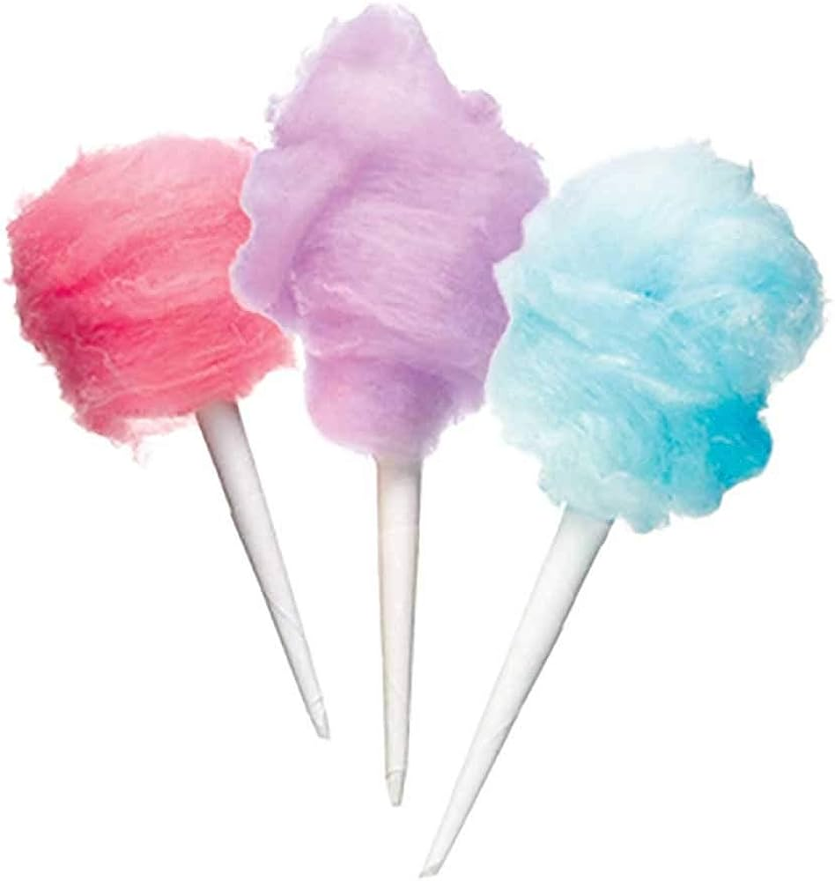
Why do cotton candy concession?
Cotton candy is one of those amazing foods which are easy to prepare & provide!
Making cotton candy is incredibly easy with the right equipment in place
Our flavors are indeed a crowd pleaser & guarantees to put a smile on every face!
Cotton Candy machines & the ingredients are extremely economical
Colorful, attractive item
The ROI is remarkably quick
Low food cost

Slide 4
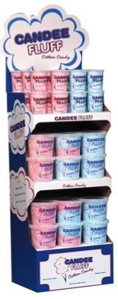
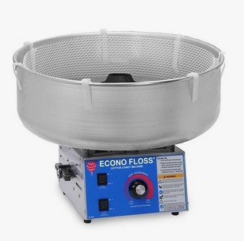
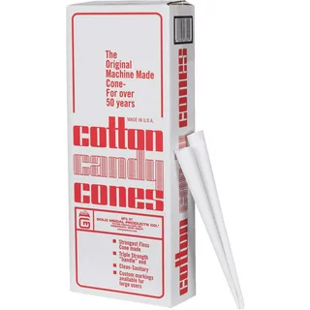
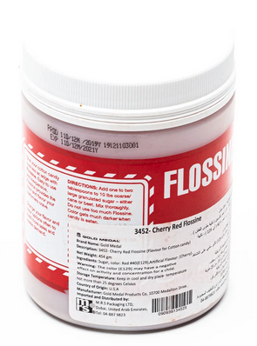
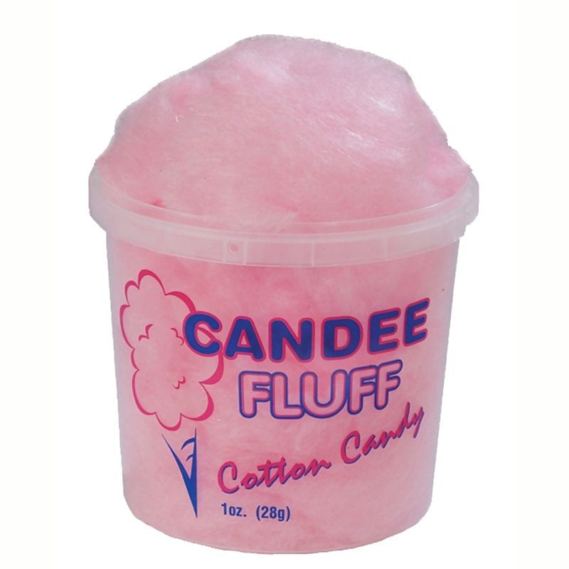
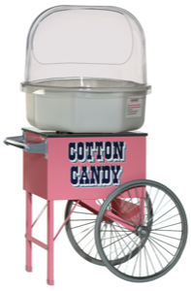
What do you need for your set-up?
Cotton Candy Machine
Flossine Concentrated Flavor + Sugar
Cones, Bags or Air-Tight Plastic Containers
Attractive Display
Cotton Candy Stand

Slide 5
Cotton candy equipment
#3943 – Clear Double Bubble
To better control your spinning cotton candy & maintain safe operation, add a virtually indestructible bubble to your machine setup.
#3017 – Econo Floss
This deluxe version of the Econo Floss features a stainless-steel cabinet, spun aluminum bowl & the Whirl Grip Floss Stabilizer.
Price AED 1,600.00
Price : 6100.00

Slide 6
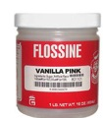

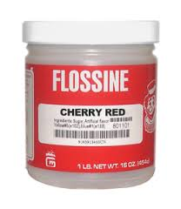


Cotton candy flavors
Mixing Instructions:
Use 1-2 tbsp. to 10 lb. sugar (either cane sugar or beet sugar)
Mix thoroughly
#3451 – Vanilla Pink Flossine
#3452 – Cherry Red Flossine
#3453 – Blue Raspberry Flossine
#3458 – Orange Flossine
#3462 – Banana Flossine
#3466 – Green Apple Flossine
Flossine are the flavors
Price per jar: AED 150/- + VAT

Slide 7
Cotton candy profit calculator
By using this module, we can fix a tentative price list for the products.
Item | Description | Packing | Price/AED | Cost per Serving/AED
3451+ | Flossines | 1x454 Grm | 150.00 | 0.07
Sugar | Sugar | 1x2 Kg | 5.00 | 0.06
3021 | Candy floss cones | 1x1000 | 175.00 | 0.17
Total cost |  |  |  | 0.30
S. Price |  |  |  | 10.00
Profit |  |  |  | 9.70
1 Can flossine + 50 Kg Sugar will 2000 cones Mixing : 1 Kilo Sugar 1 Table spoon Flossine

Slide 8
Cotton candy flavors – FLOSSINE
Assume to serve 100 customers per day & yield a profit of approximately AED 29,000.00/- per month
Your COST – Per serving
(Based on the packaging)
  AED 0.30/-
Your SELLING PRICE – Per Serving
  AED 10.00/-
Your GROSS PROFIT – Per Serving
  AED 9.70/-
Payback of investment within 7 days!

Slide 9
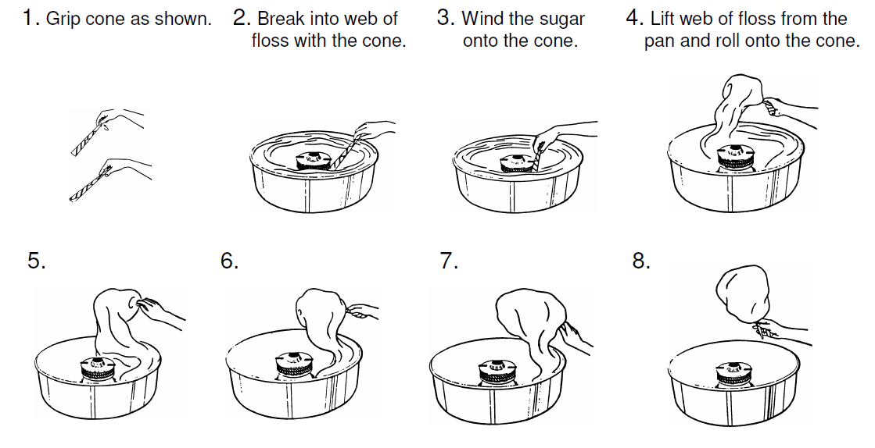
How to make cotton candy?

Slide 10
Cotton candy tips
Tips
How to put cotton candy in bags?
Bagged floss keeps a day or two, depending on the humidity
Use bags to make & display cotton candy in advance – use cones for immediate sales
If the machine will be used more than 20 feet from the power source, be sure to have an adequate extension cord
Make a Big & Fairly firm cotton candy on a stick
Hold the bag open with one hand while holding the cotton candy with the other
Twist the serving gently down into the bag
Twist the bag with the cone & floss inside, tie & display.

Slide 11
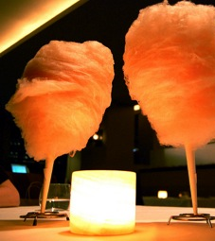
Cotton Candy was originally called Fairy Floss. It was also called Spun Sugar!
Cotton Candy has only one ingredient, sugar.
Fairy floss has been around since the 14th century, when it was a popular home-made treat.
The first cotton candy machine was patented in 1899 by Wharton & Morisson.
Cotton Candy was a huge success upon its arrival at the World’s Fair in 1904.
Fairy Floss and Spun Sugar started being called Cotton Candy in the 1920s.
National Cotton Candy Day is celebrated on November 7th.
Nifty facts on cotton candy!

Slide 12
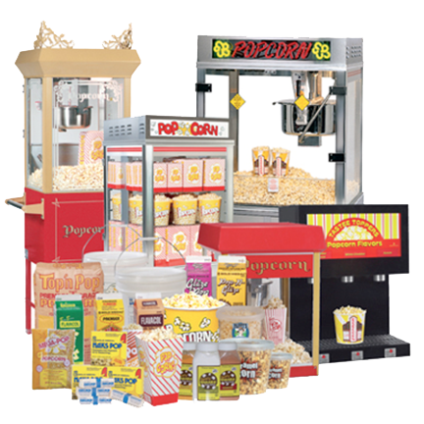
M.R.S. Packaging Ltd
P.O.Box: 17074 | DWC Plot WB56 & WB57 | Dubai Logistic City| DWC | Dubai World Central | Dubai, United Arab Emirates
Telephone: +971 4 887 9823
Manu Soni
Mobile: +971 50 644 7931
Email: msoni@mrspackaging.com
Website: www.mrspackaging.com
Contact M.R.S. Packaging Ltd

