Slide 1
One Stop Solution for Large Venues, Theme Parks, Cinemas and Sporting arenas.
M.R.S PACKAGING LIMITED
(GCC & MIDDLE EAST)

Slide 2
Profitability of Concession Stands Measuring Success
Concession sales per person
Average transaction amount
Average transaction time
Percentage of box office

Slide 3
Our Services
Pre- Opening and inception of Project
Based on expected foot fall advise on selection of F & B offerings.
Selection of right fit equipment and budgeting.
Space and Power required.
Concession design based on optimum flow of preparation and servings.
Supply of All food raw materials

Slide 4
After sales service includes
Assisting installation and commissioning of concession equipment
Training to customer’s staff on operation and maintenance of equipment.
SOP for food preparations and recipes
Periodic audit of customer’s operation (for equipment supplied by us to ensure customer’s staff follow good practices, Sop and recipes).
On going service for equipment supplied by us.
Uninterrupted supplies of contracted food supplies.
On going new ideas and suggestion on expanding menus within existing scope of offerings.

Slide 5
Equipment Options for large venues
Popcorn Machines and staging cabinets
Nachos Machines
Slush Machines
Crepes and waffle Machines
Cotton candy (Cotton Candy Machines)
Fries and Hot dog Machines
Gourmet Popcorn Machines

Slide 6
Equipment & Supplies
We are distributors of reputed supplies for food supplies for above mentioned equipment.
Supplies includes:
Popcorn
Popcorn Kernels (Raw Popcorn) of best quality
Popping Oils
Flavors both Savory and sweet
Popcorn Seasonings

Slide 7
Popcorn Supplies & Equipment

Slide 8
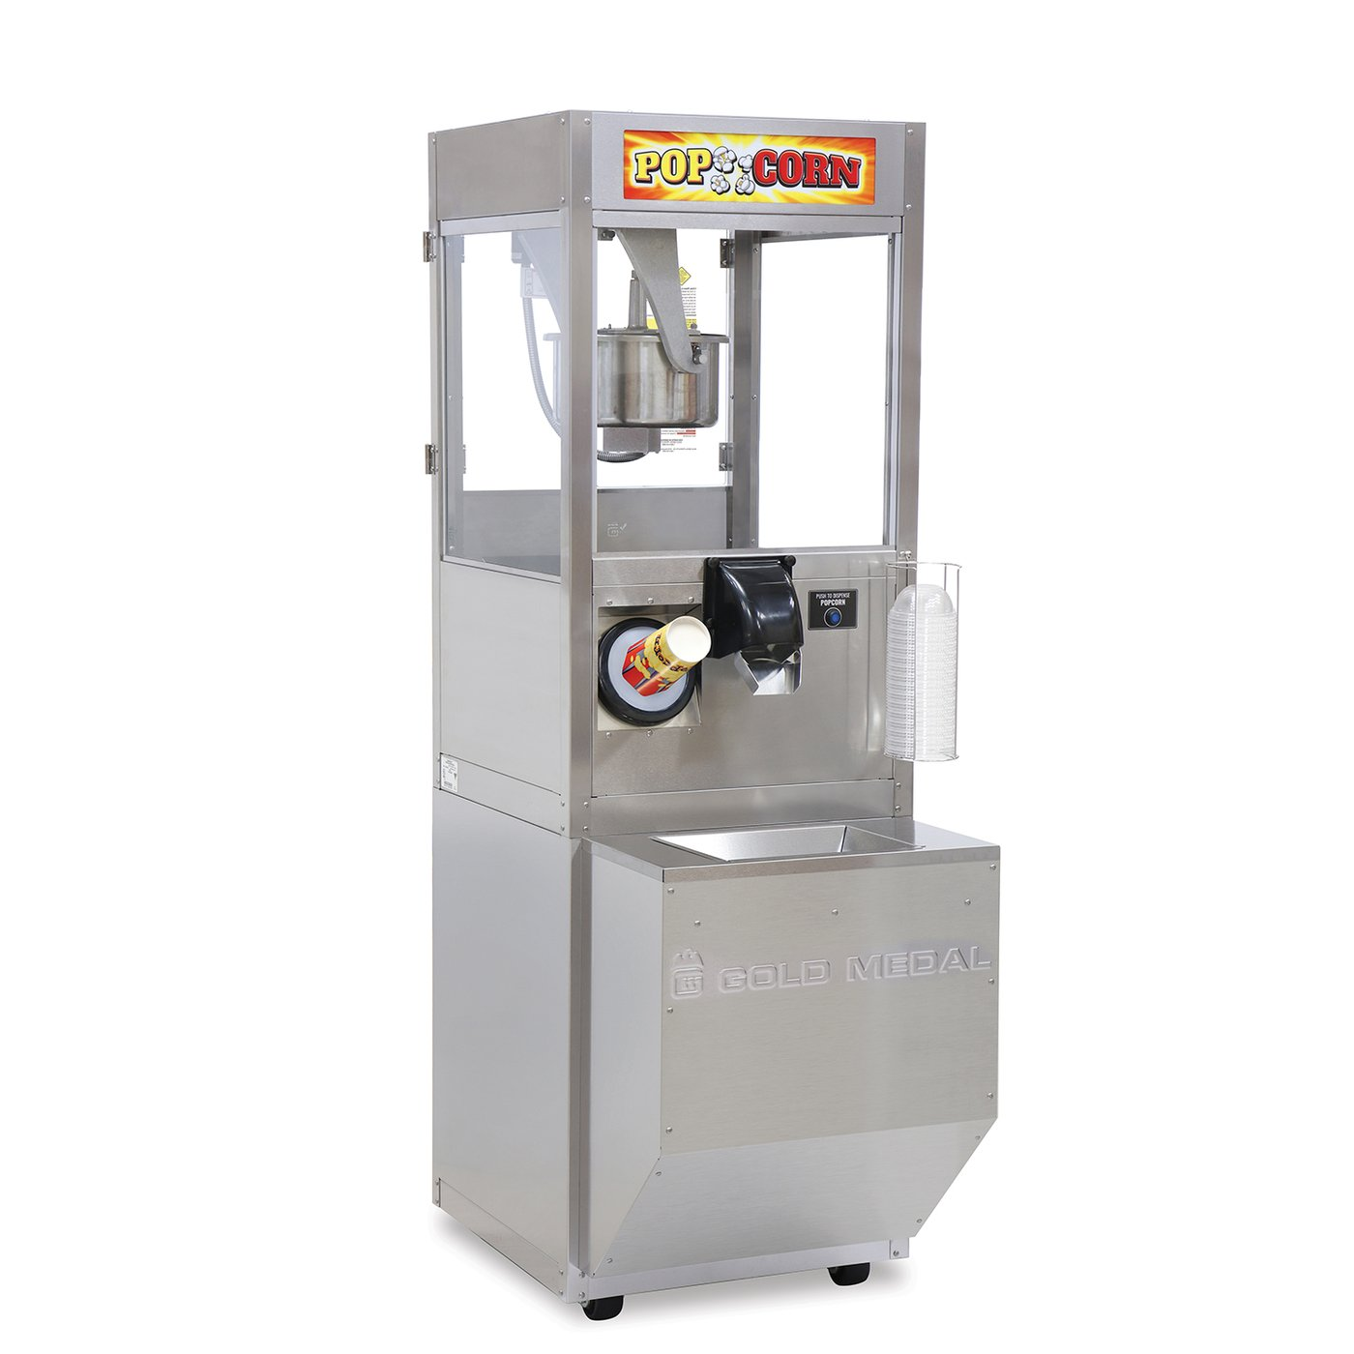
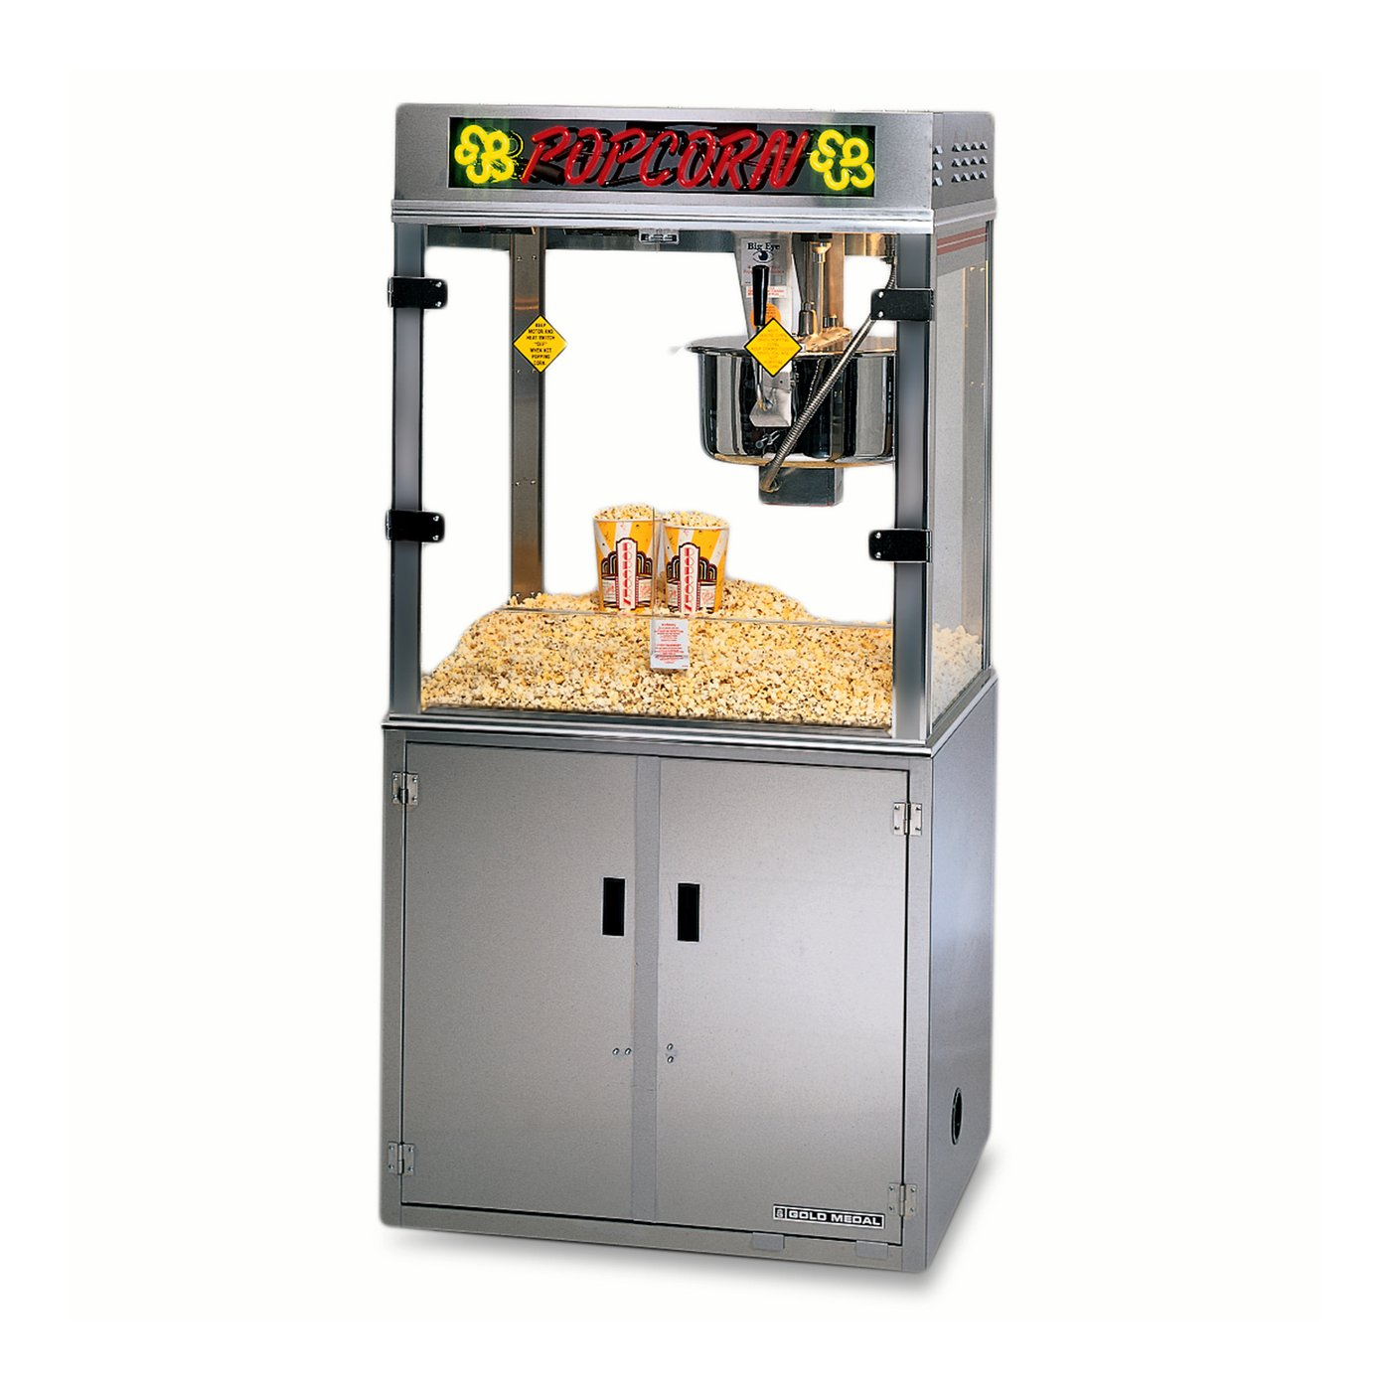
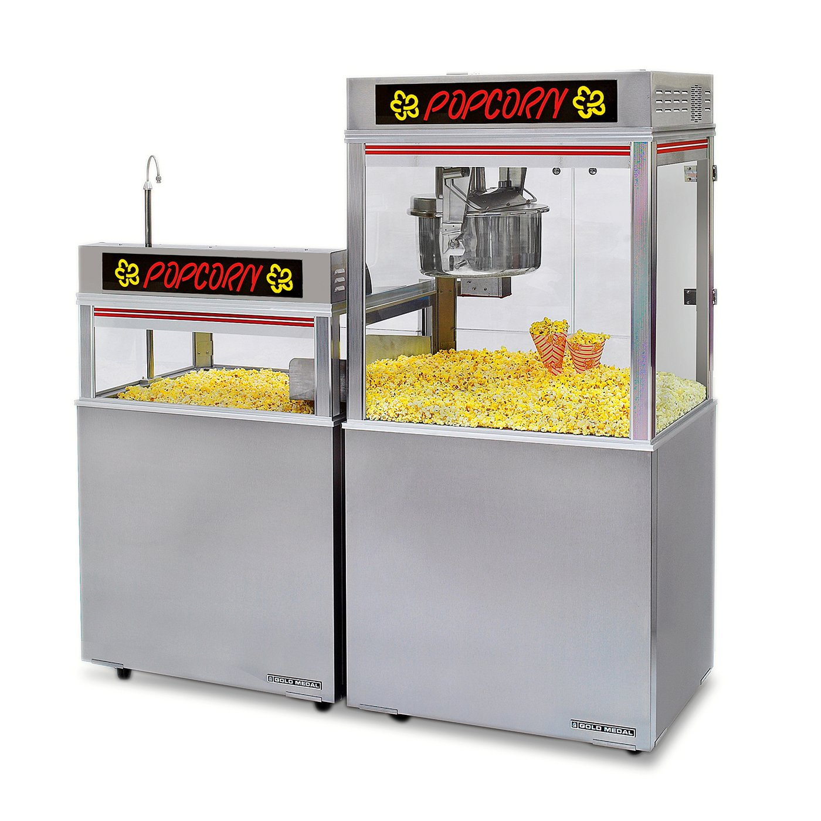
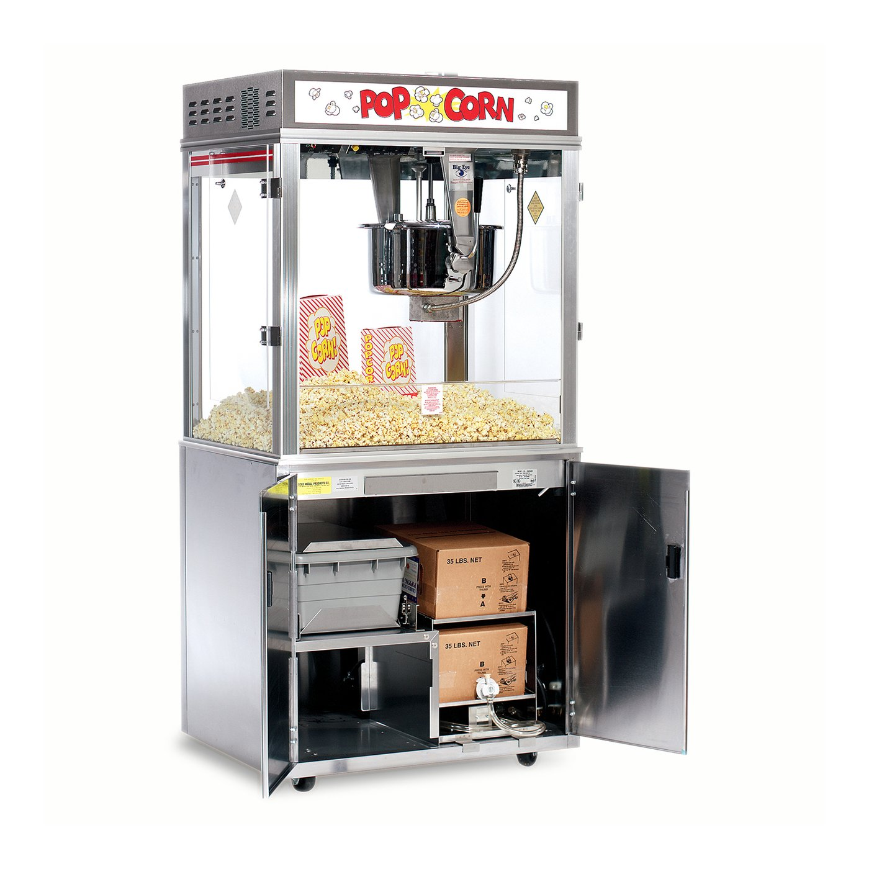
Popcorn Machine
ReadyPop® Popper
Pop-O-Gold 32-oz. with LED Neon Sign & Base
Pop-O-Gold 32-oz. with Chute
Pop-O-Gold 32-oz. Floor Model with BIB Oil System

Slide 9
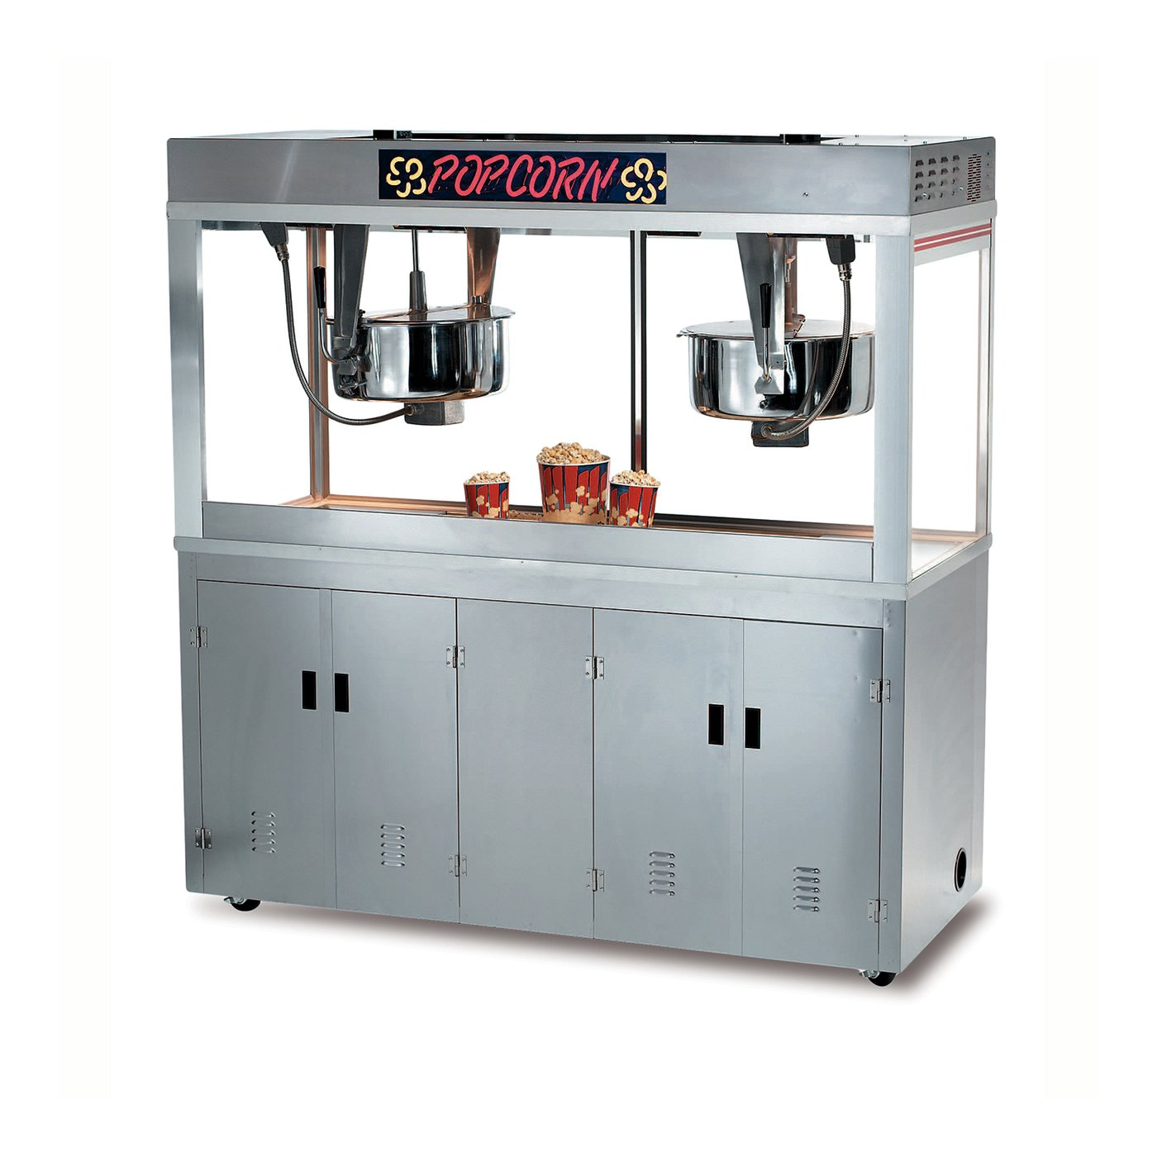
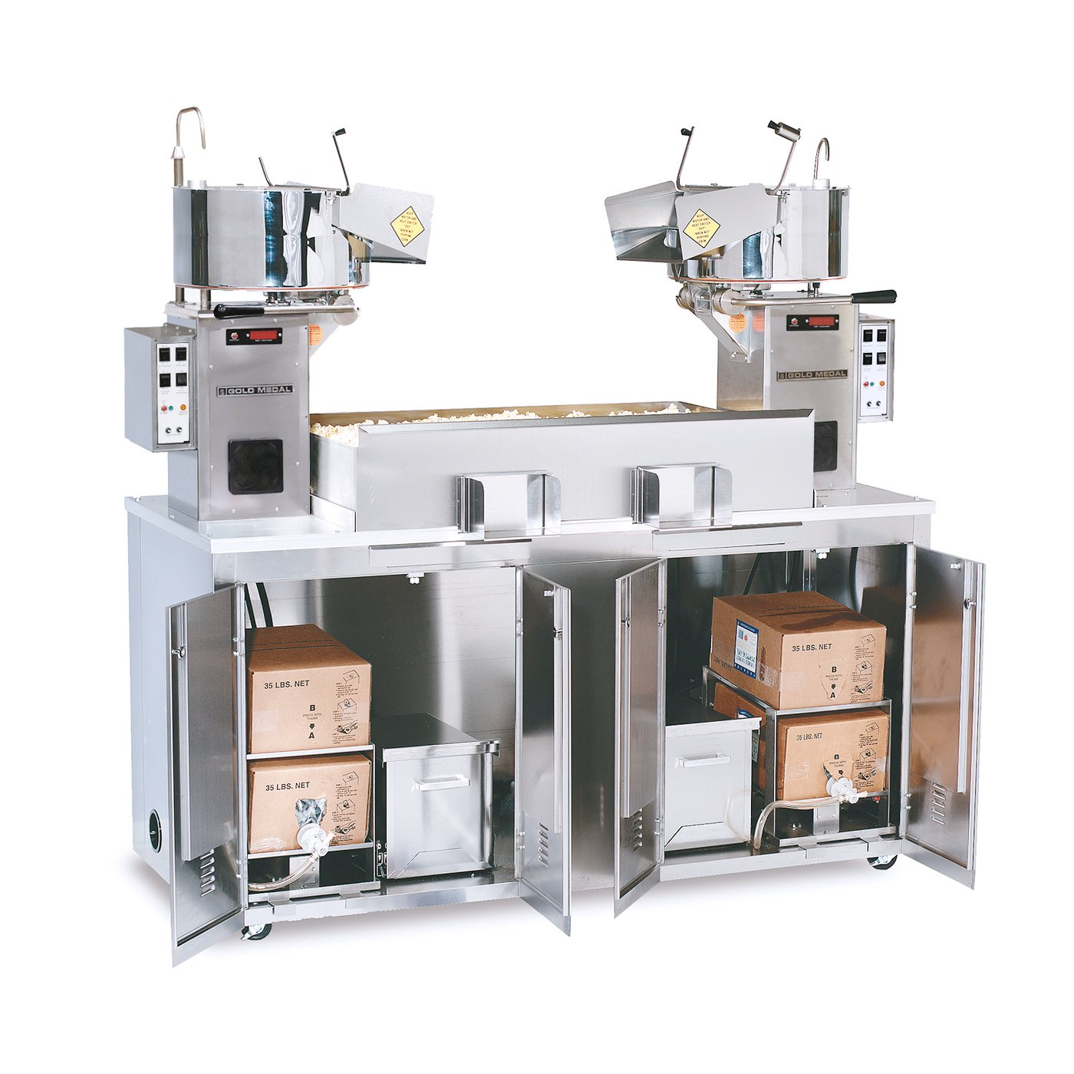
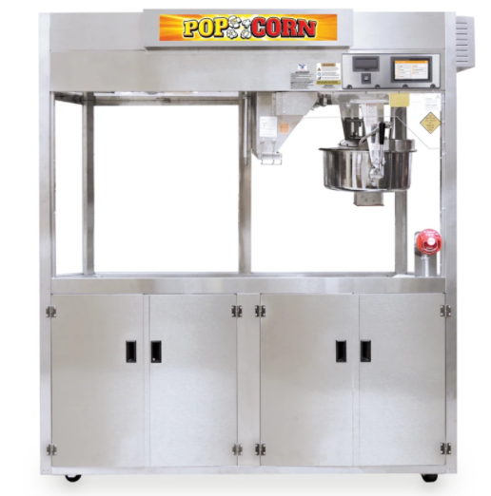
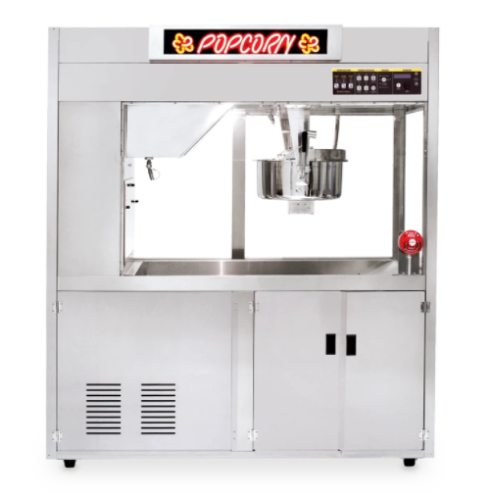
Popcorn Machine
Twin Medallion 52-oz. Popper with LED
Twin Grand Pop-O-Gold 32-oz. Popper
PopClean® Elite Popper® Series with Precision Pop® Technology - Touch Screen Controls
PopClean® Elite Popper® Series with Precision Pop® - Advanced Membrane Controls

Slide 10
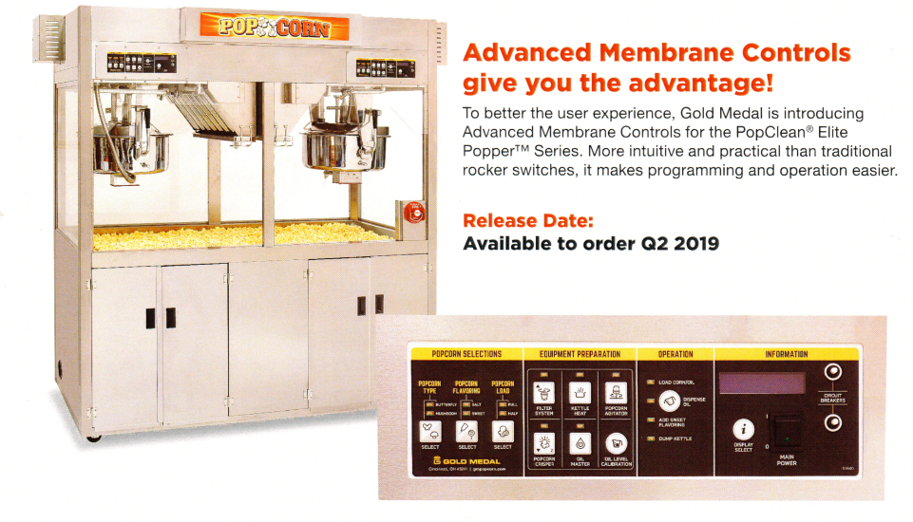
Advanced Membrane Controls for Pop clean Elite Popper Series

Slide 11
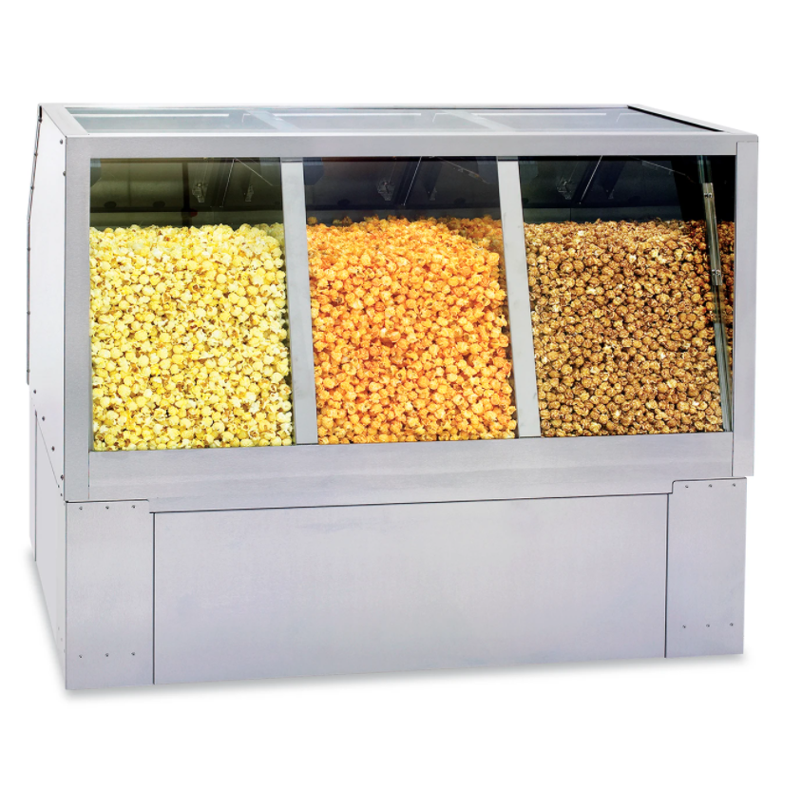
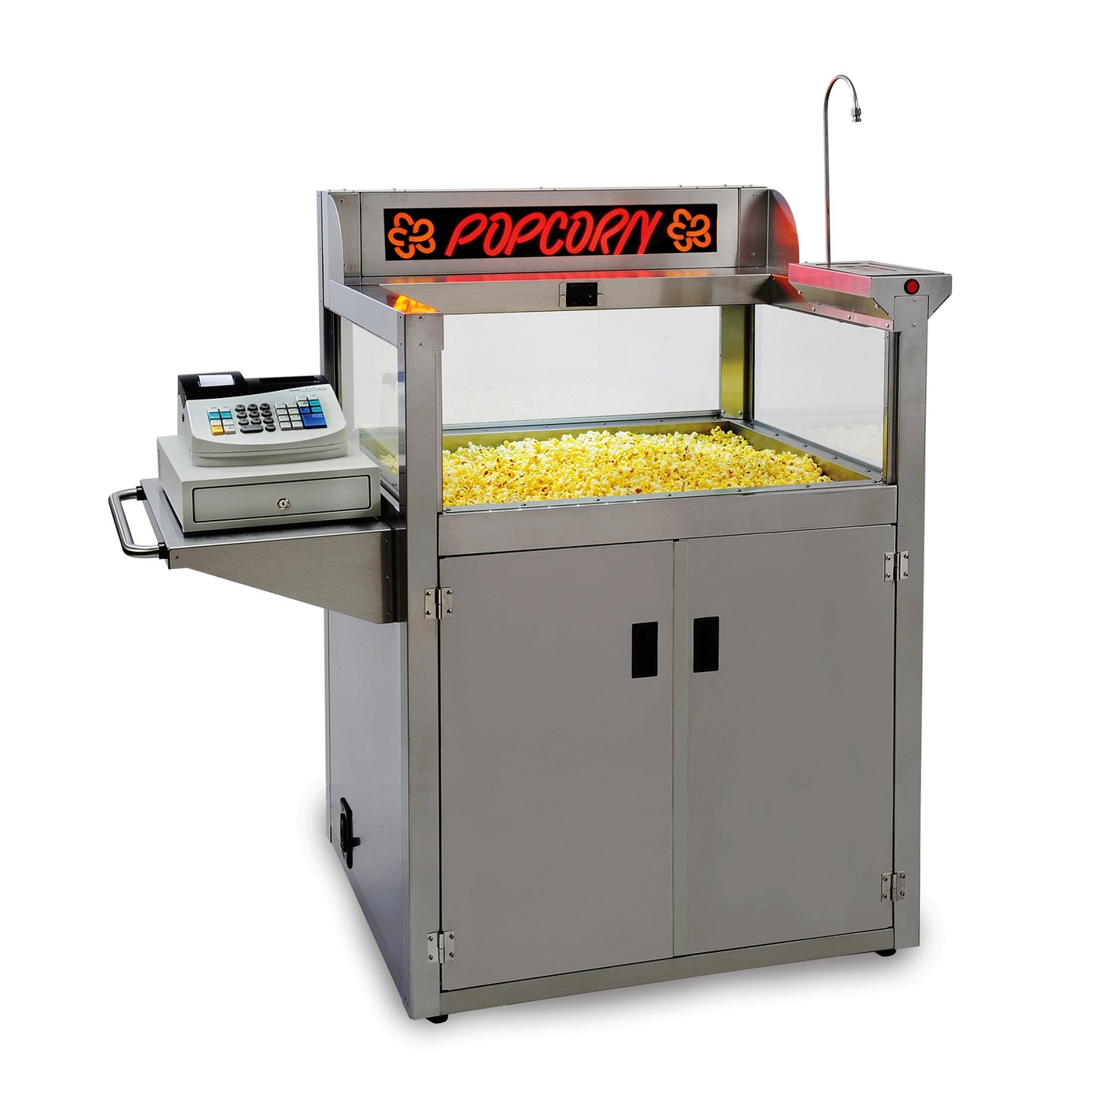
Staging Cabinet (Warmer)
54" Main Street Elite Popcorn Staging Cabinets ‒ Triple Compartment
48" Main Street Elite Popcorn Staging Cabinets ‒ Triple Compartment
Crisper – Build in Counter

Slide 12
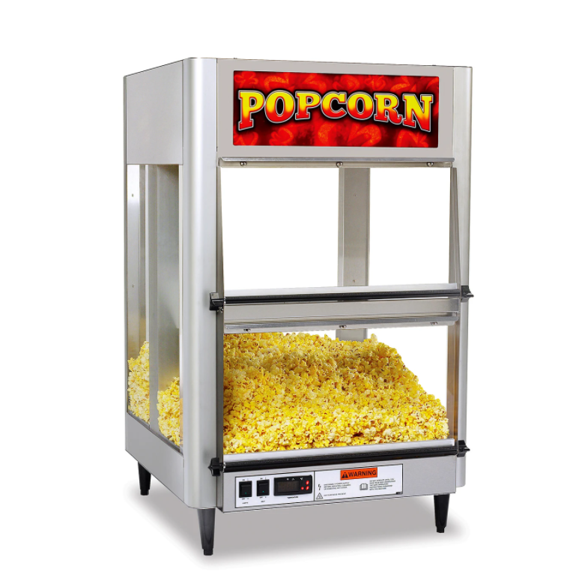
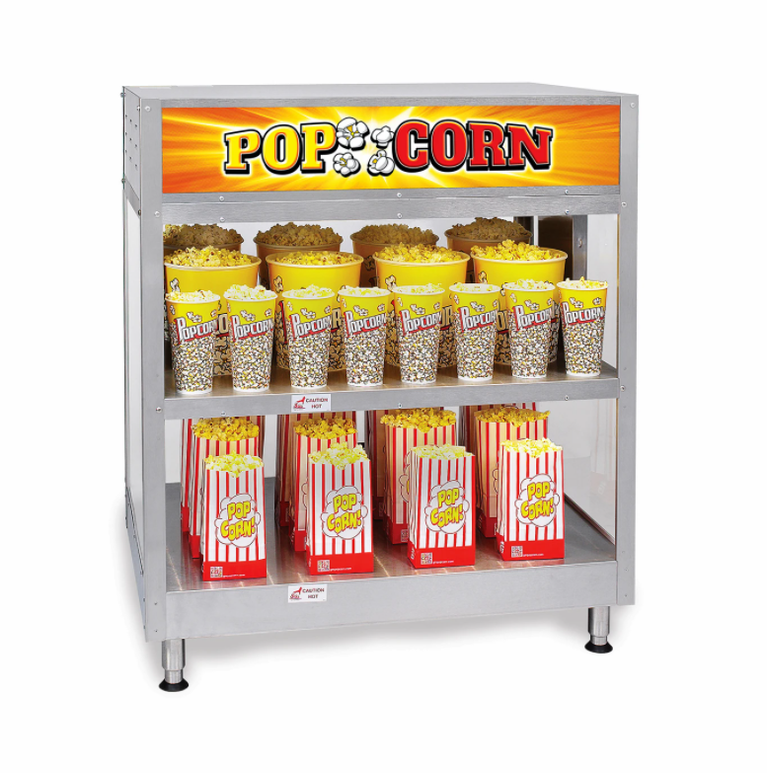
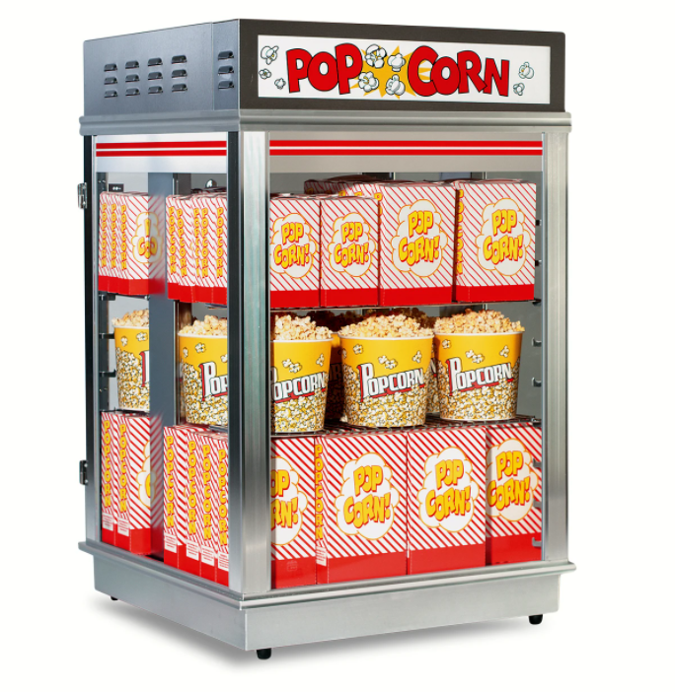
Staging Cabinet (Warmer)-Tabletop
Bulk Popcorn Staging Cabinet
Staging Cabinet (36")
Astro Popcorn Staging Cabinet - Sliding Doors

Slide 13
Season your Popcorn with amazing Seasonings

Slide 14
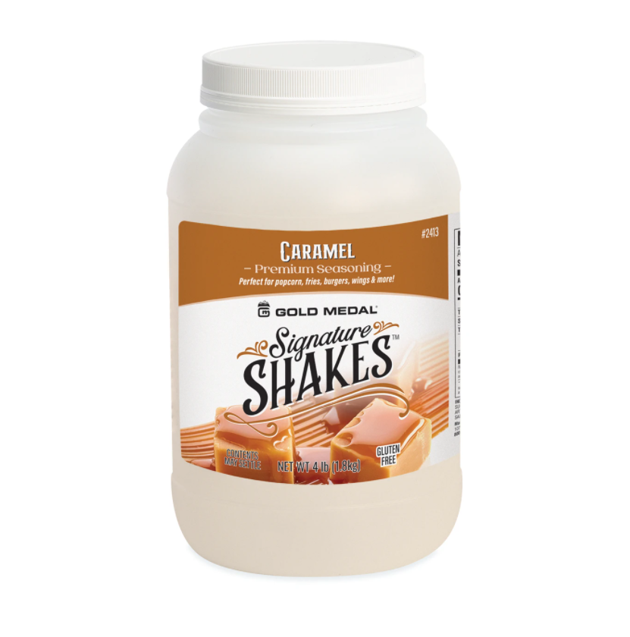
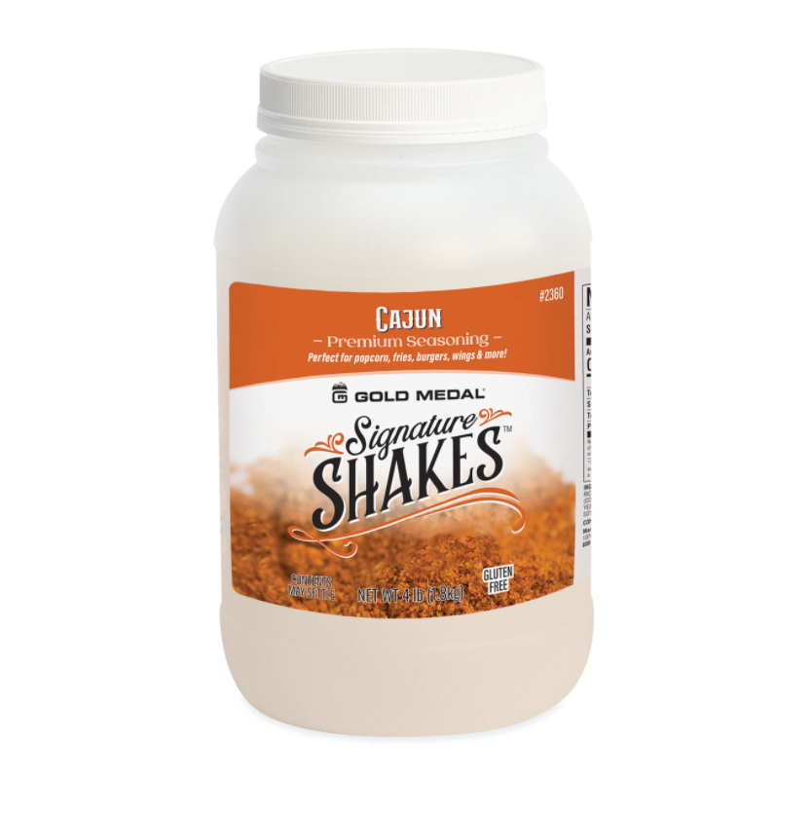
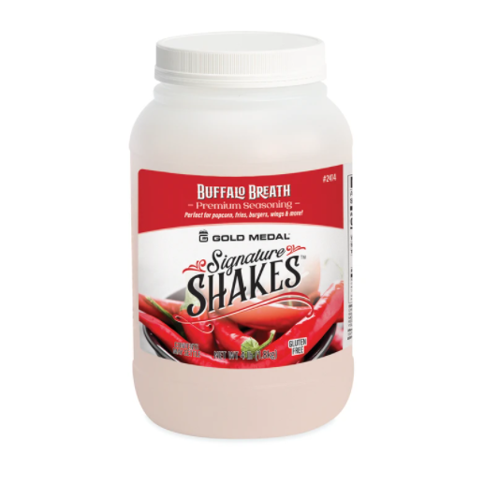
Flavors & Seasonings
Caramel
Cajun
Buffalo Breath
Barbecue

Slide 15
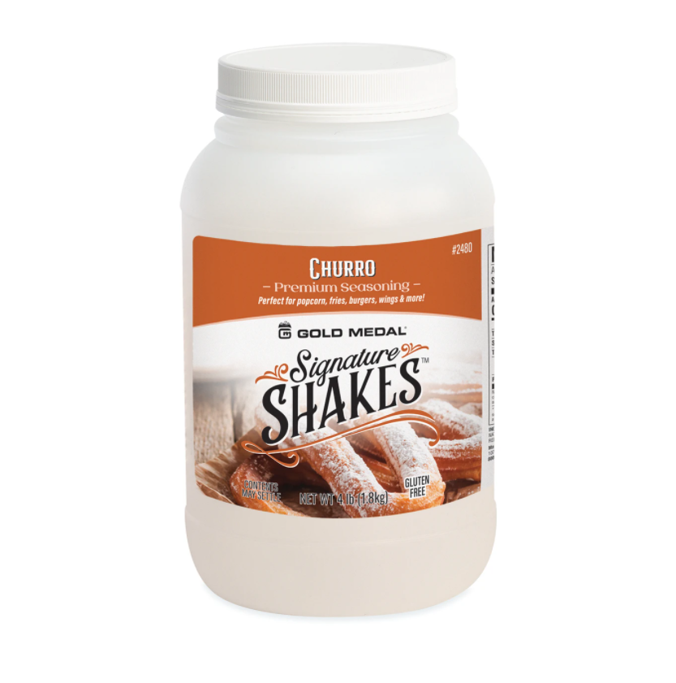
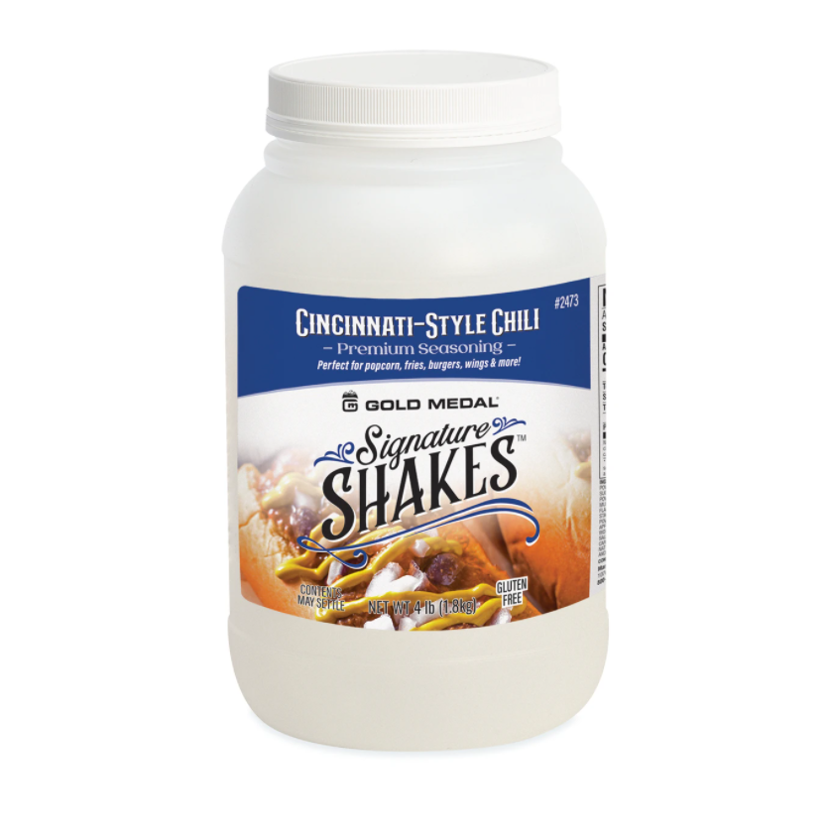
Flavors & Seasonings
Churro
Cheddar Cheese
Cincinnati Style Chili
Dill

Slide 16
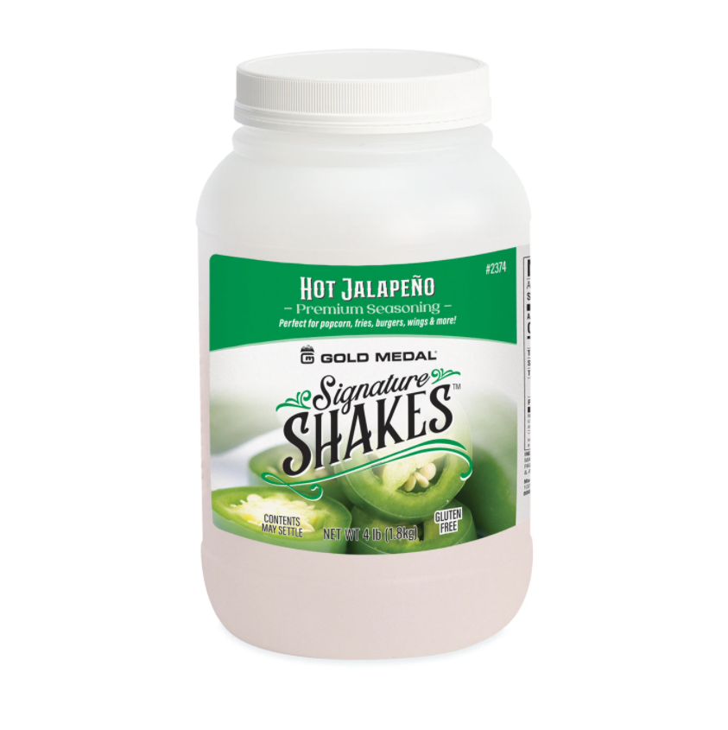
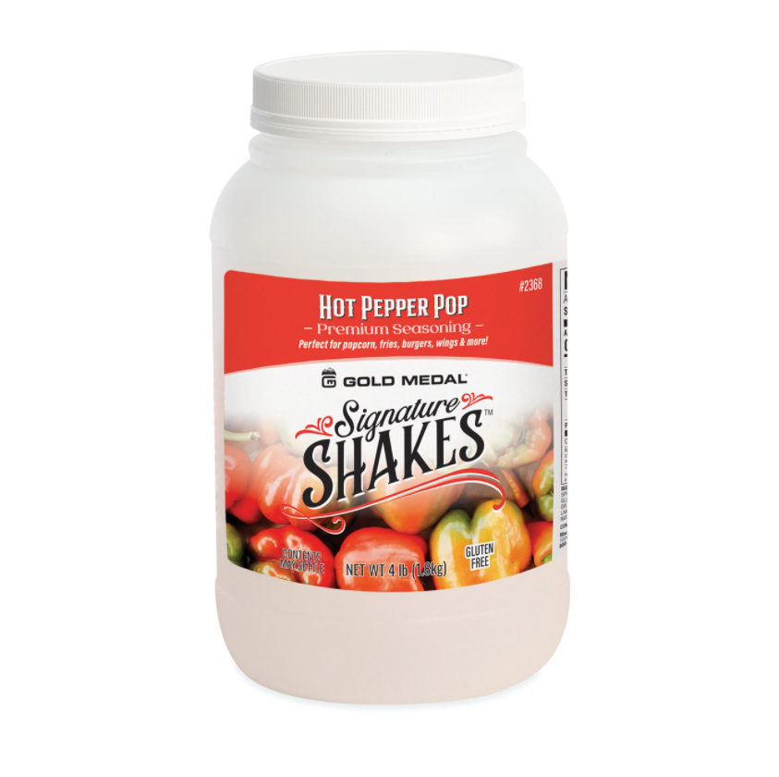
Flavors & Seasonings
Hot Jalapeno
Garlic Parmesan
Hot Pepper Pop
Honey Mustard

Slide 17
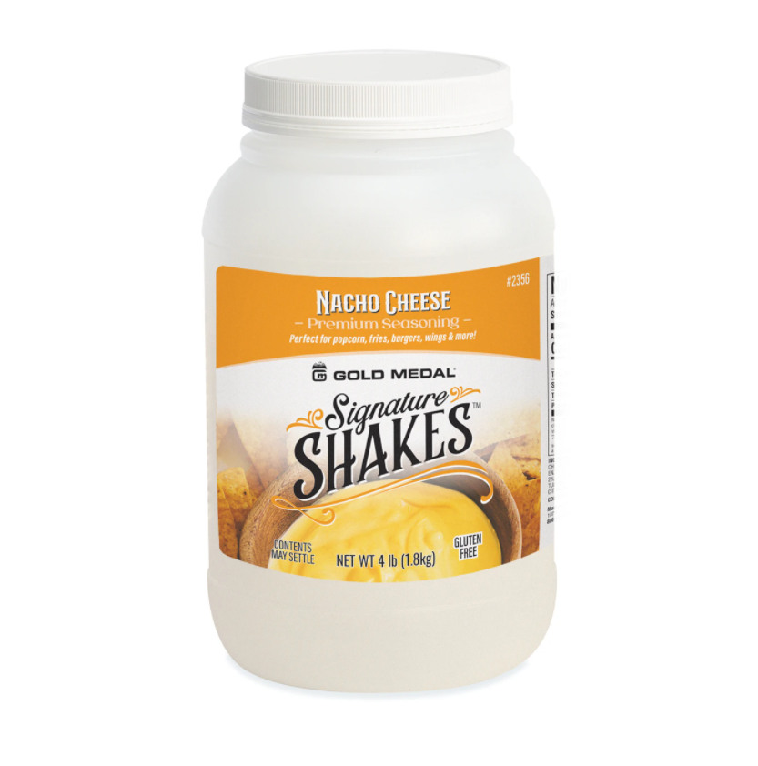
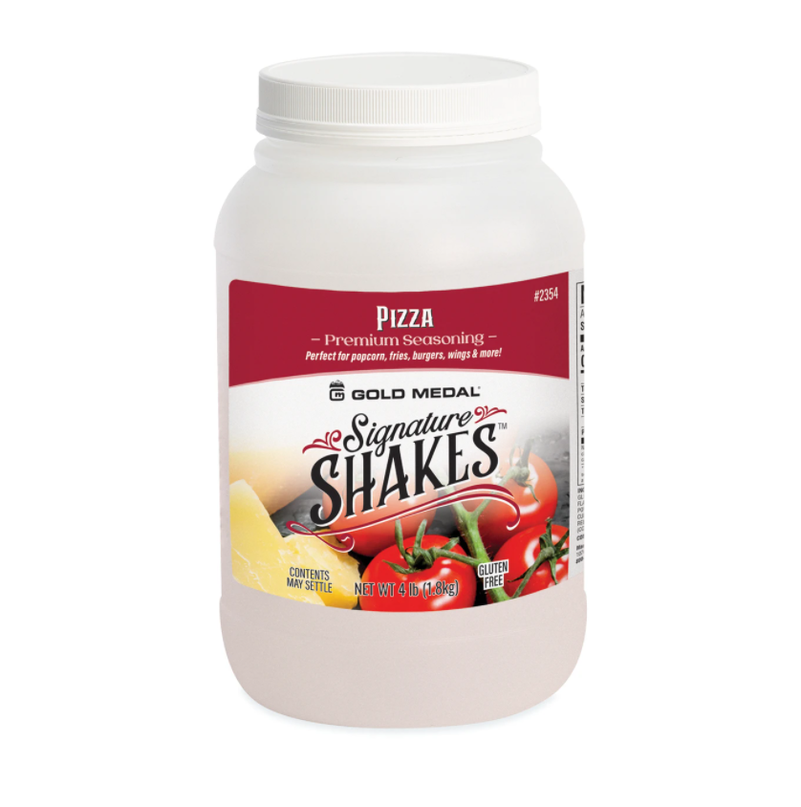
Flavors & Seasonings
Nacho Cheese
Pizza
Lemon Pound Cake
Mediterranean Herb

Slide 18
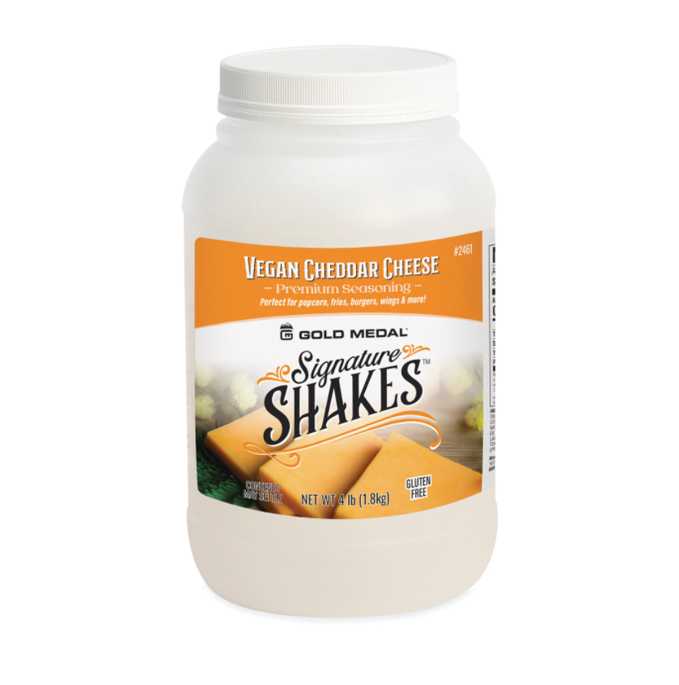
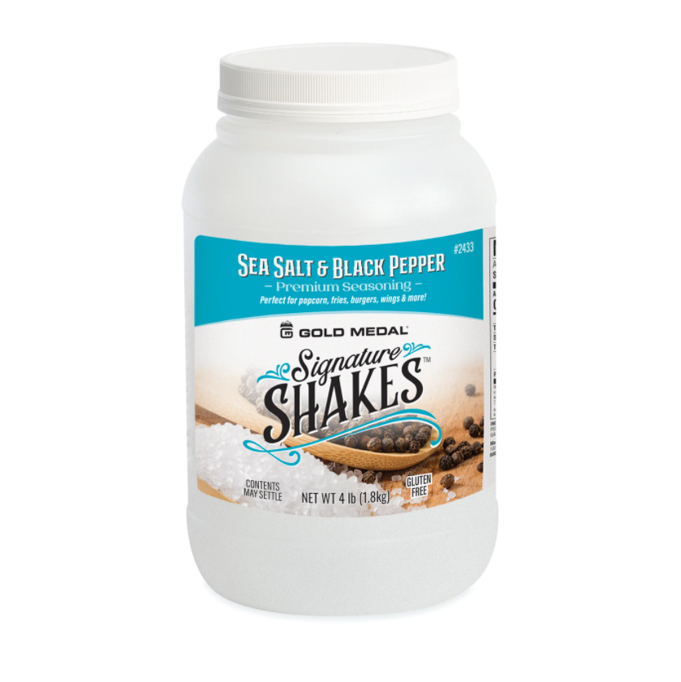
Flavors & Seasonings
Vegan Cheddar Cheese
Ranch
Sea Salt & Black Pepper
Sour Cream & Chives

Slide 19
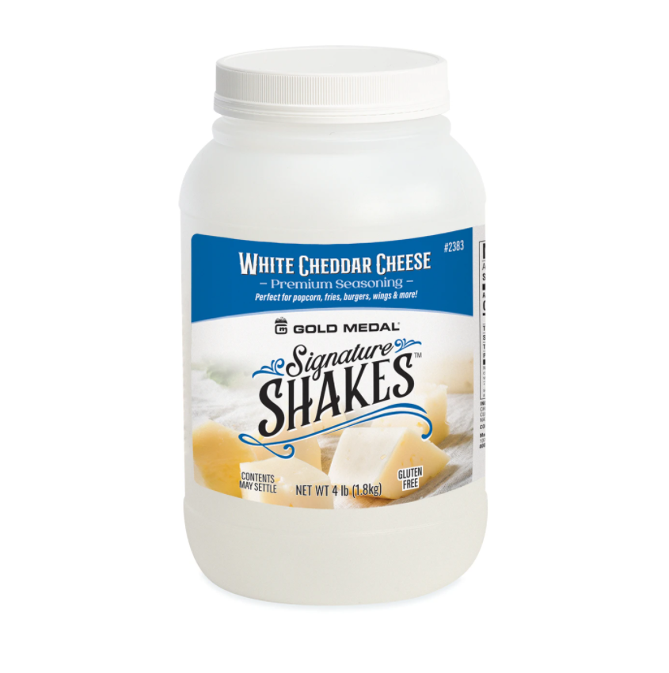
Flavors & Seasonings
White Cheddar Cheese
Wasabi

Slide 20
Nacho Supplies & Equipment

Slide 21
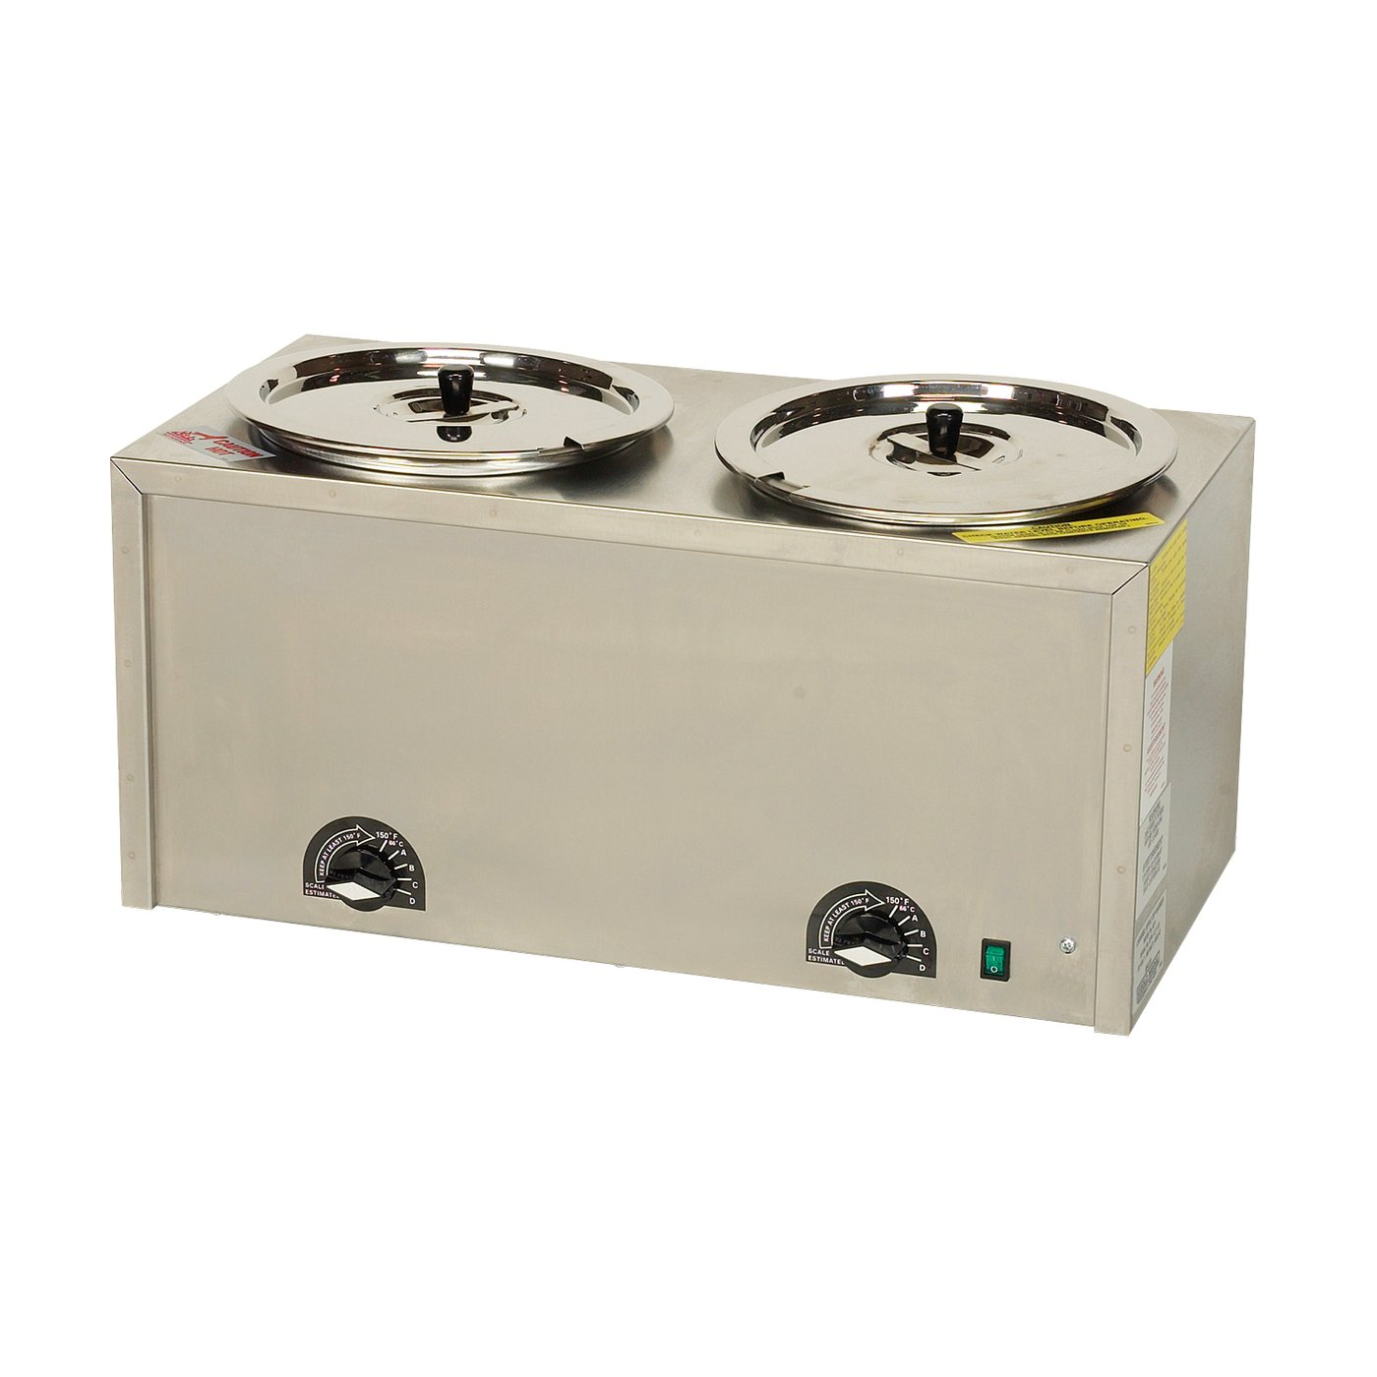
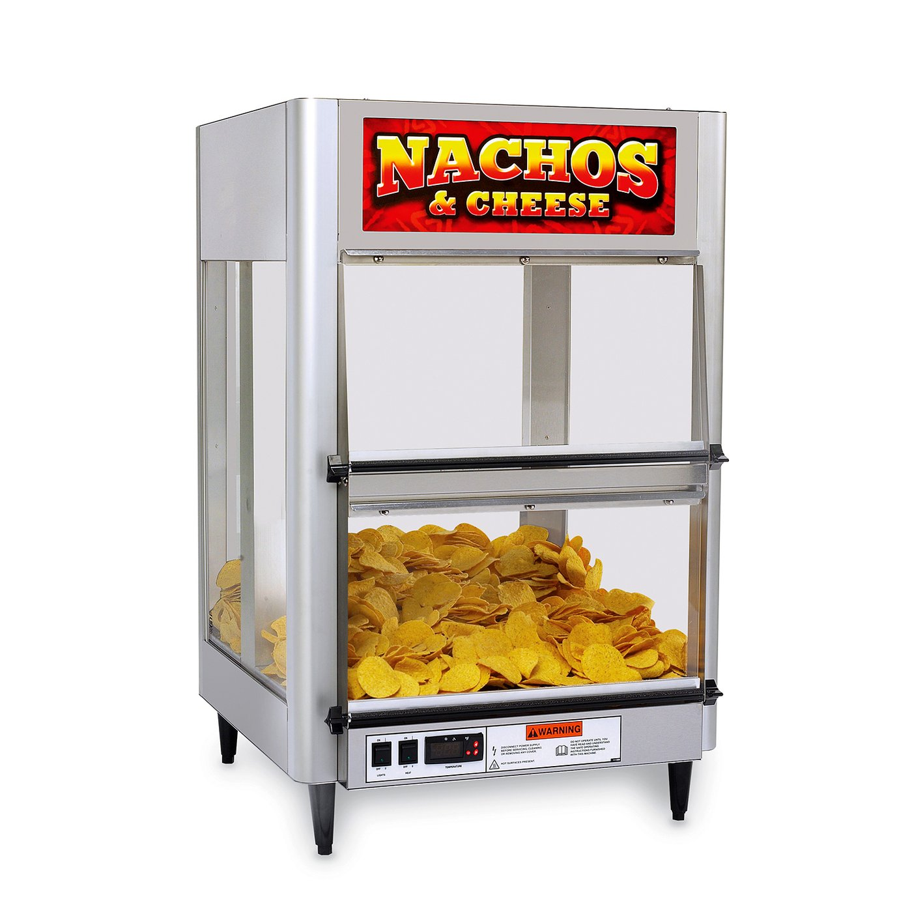
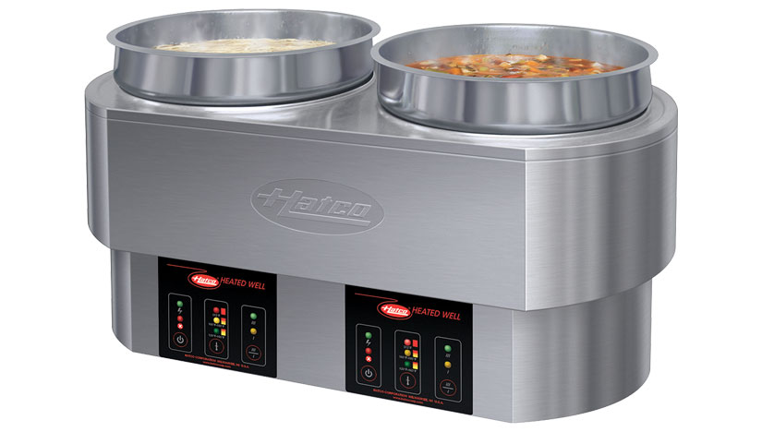
Nacho Equipment
Twin Warmer
Bulk Nacho Warmer
Round Heated Well

Slide 22
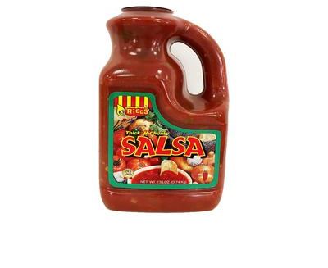
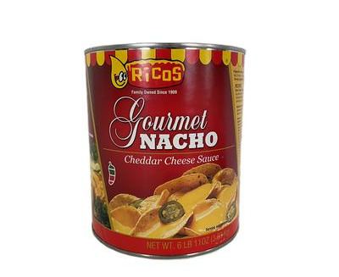
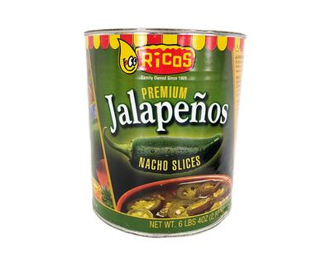
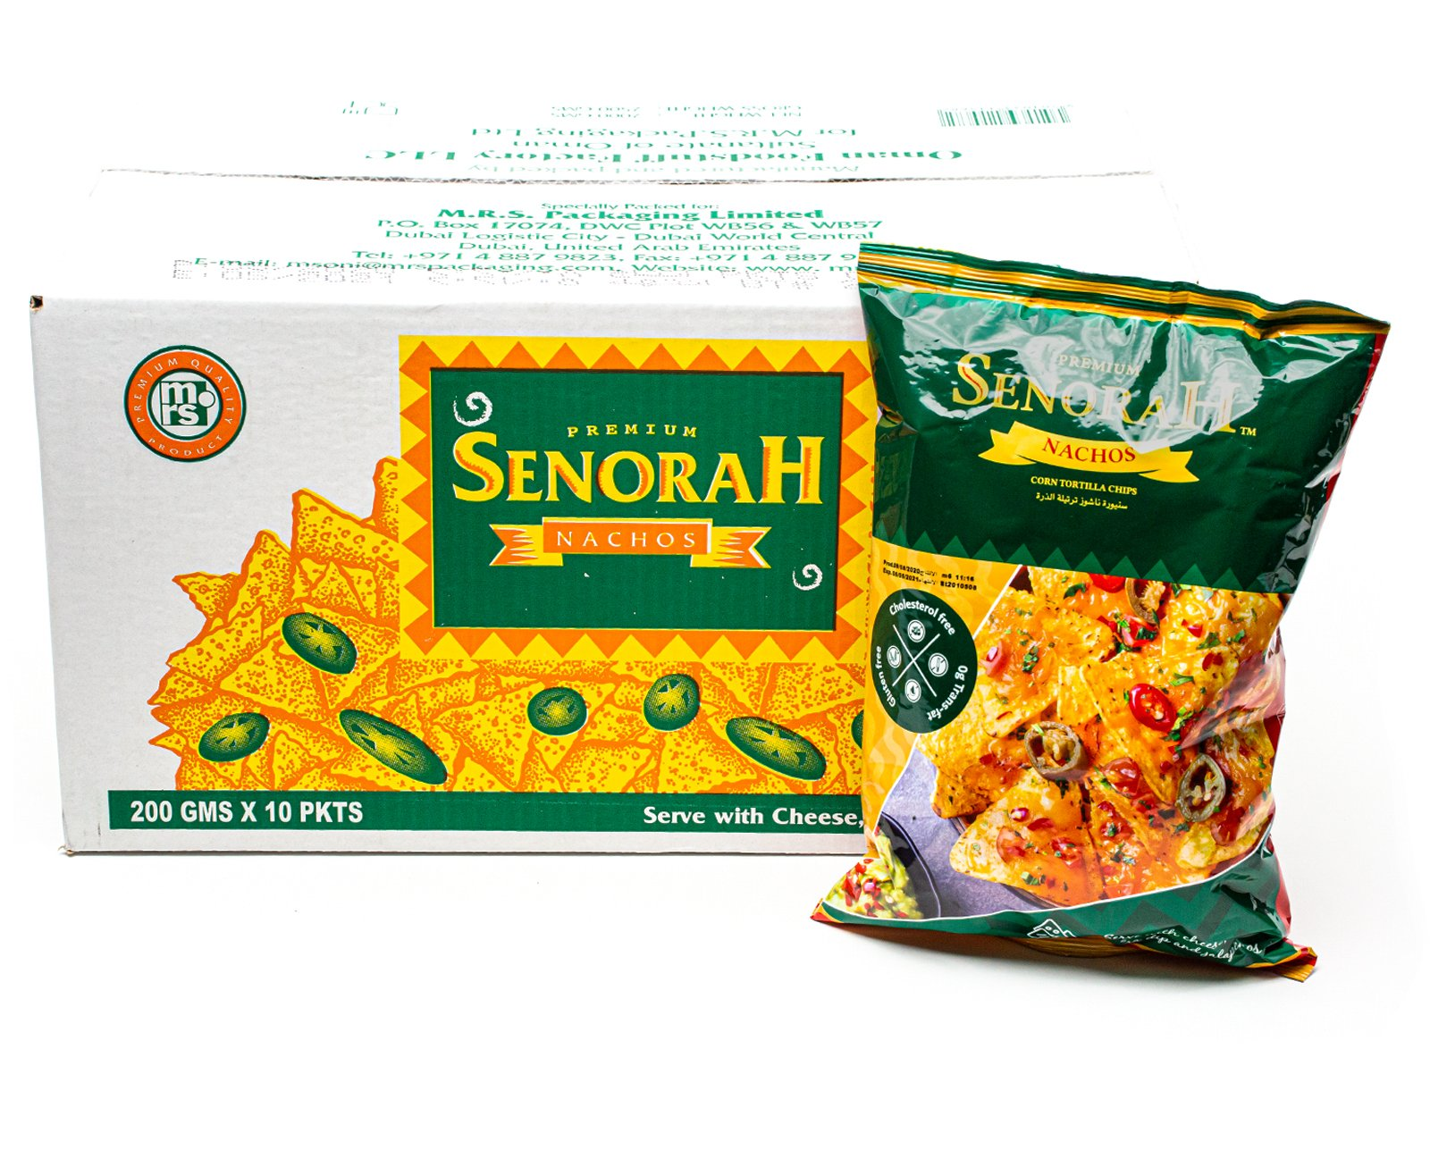
Nacho Supplies
Thick N’ Chunky Salsa
Cheddar Cheese Sauce
Jalapenos Slices
Senorah Nachos

Slide 23
Slush Supplies & Equipment

Slide 24
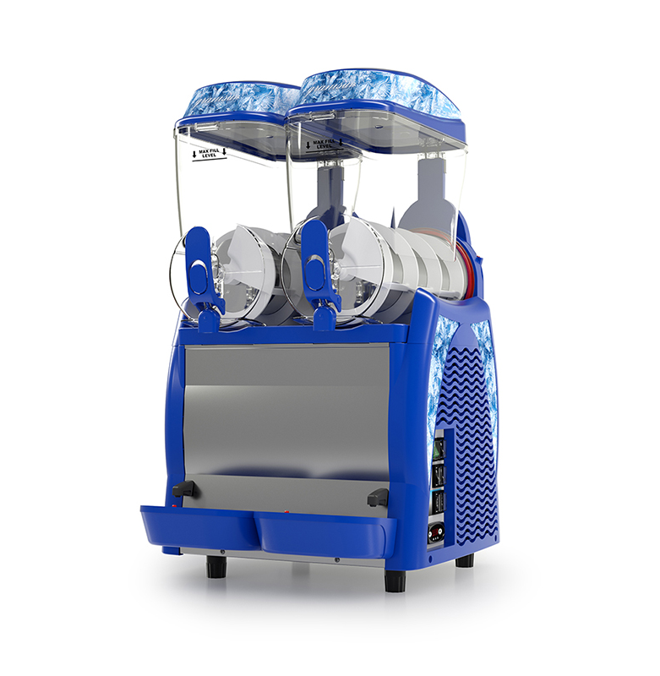
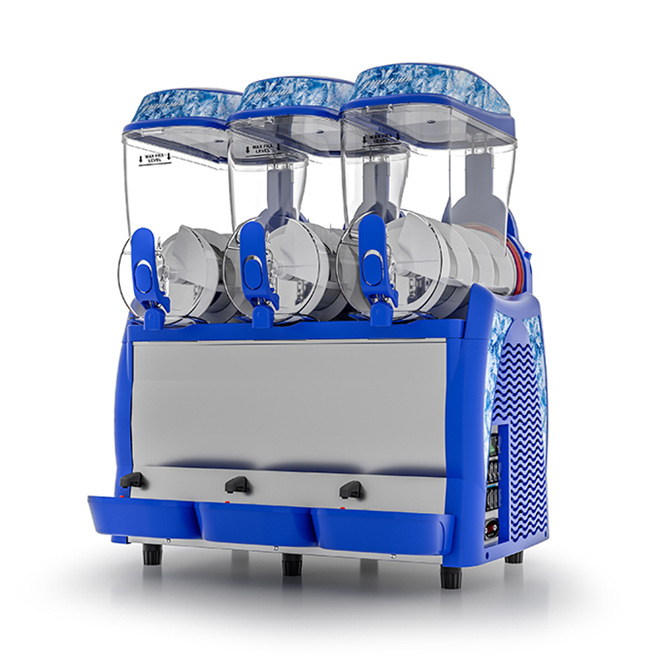
Slush Machine
Two Compartment
Three Compartment

Slide 25
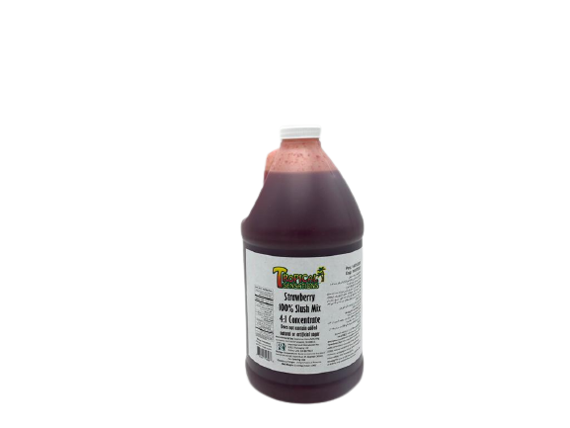
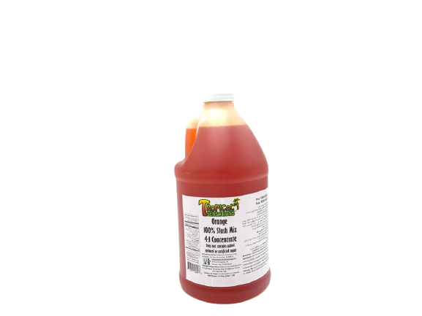
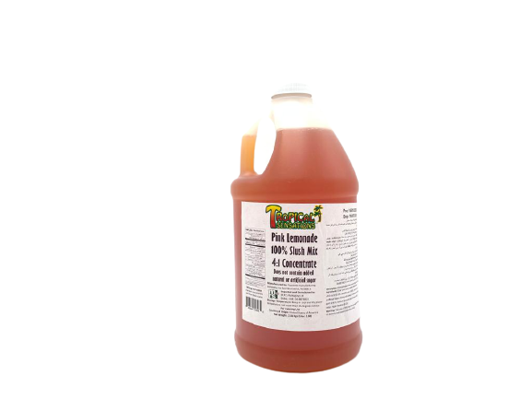
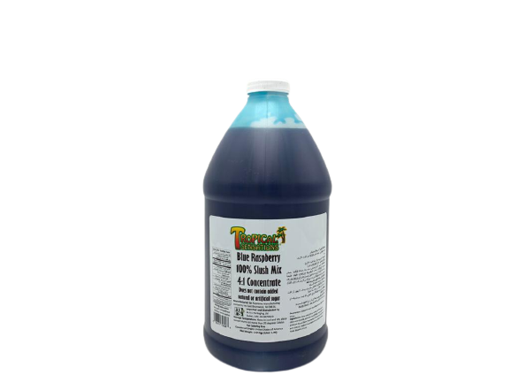
Slush Mix: Choice of 100% Fruit based slush mixes.
Strawberry
Orange
Pink Lemonade
Blue Raspberry

Slide 26
Cotton Candy Supplies & Machine

Slide 27
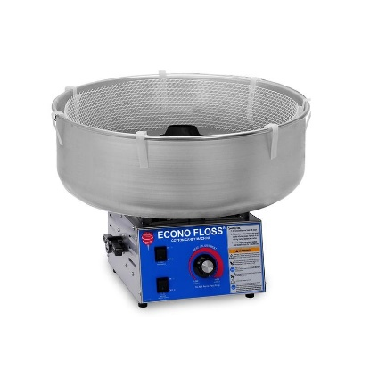
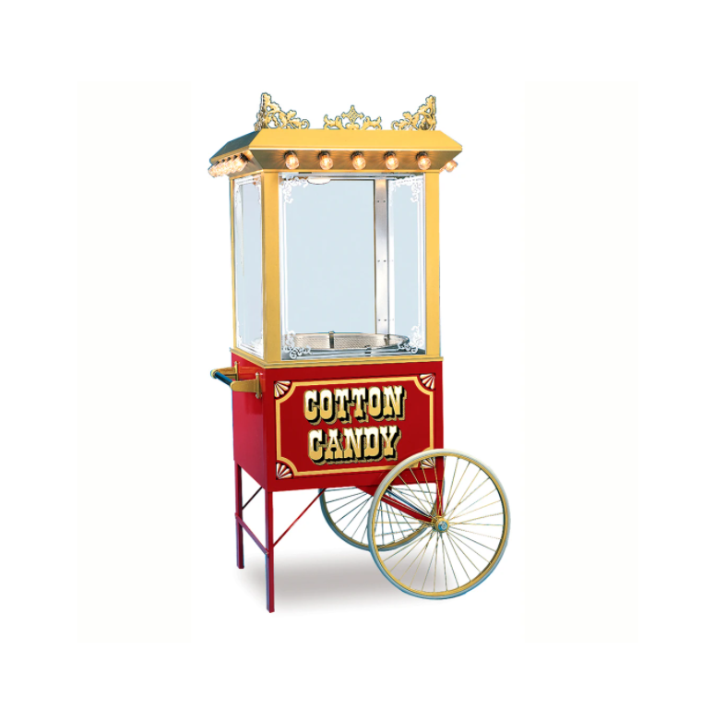
Cotton Candy Machine
COTTON CANDY MACHINE
COTTON CANDY CART

Slide 28
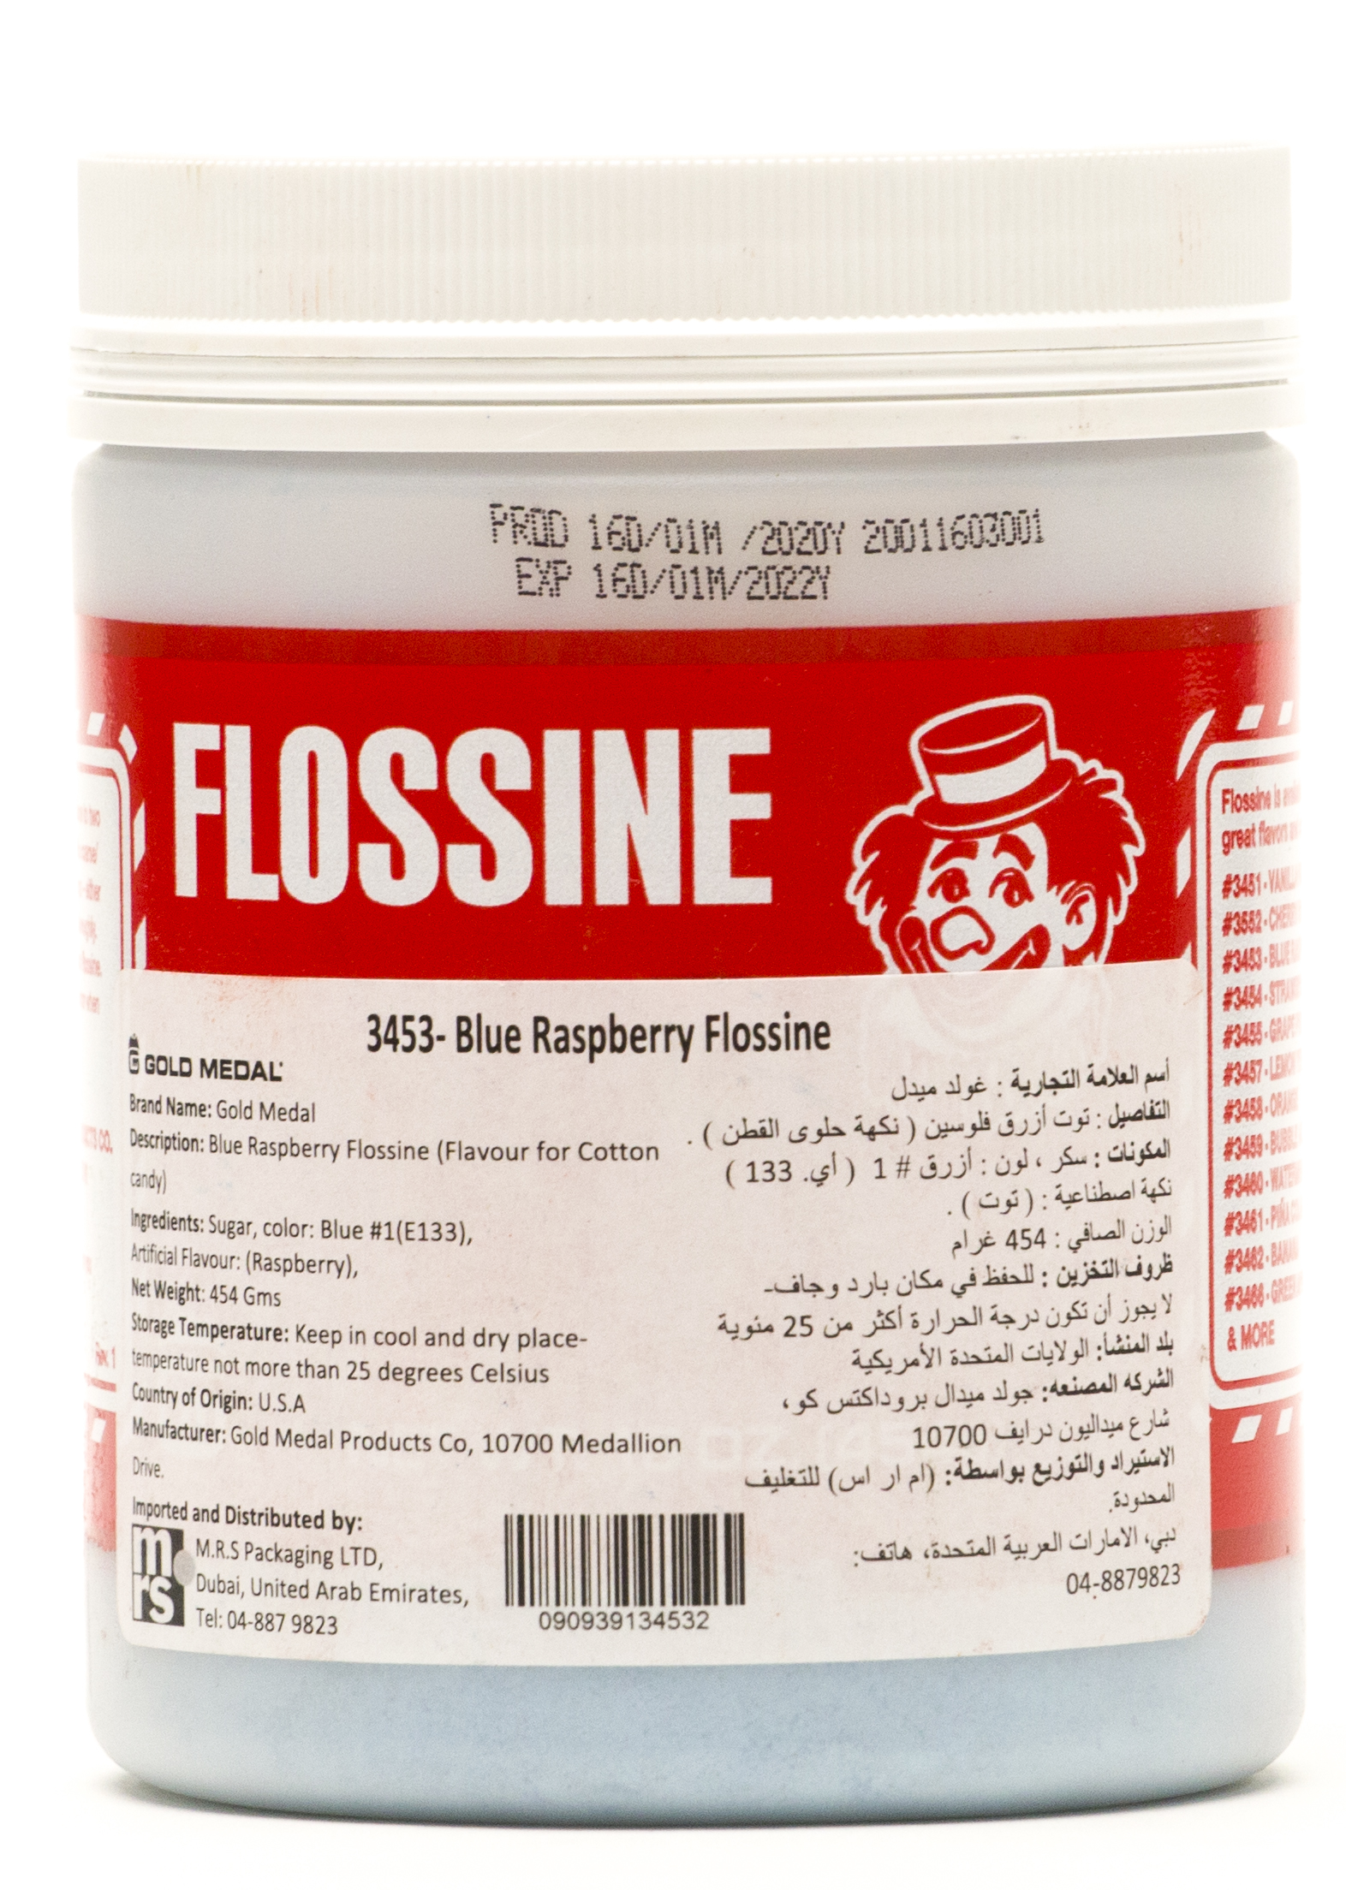
Cotton Candy Flossine
Blue Raspberry Flossine
Strawberry Flossine
Cherry Red Flossine
Vanilla Pink Flossine
Orange Flossine
Banana Flossine

Slide 29
Crepe, Waffle & Pancake

Slide 30
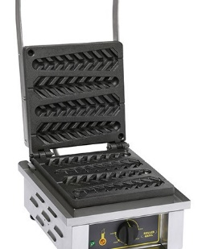
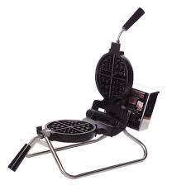
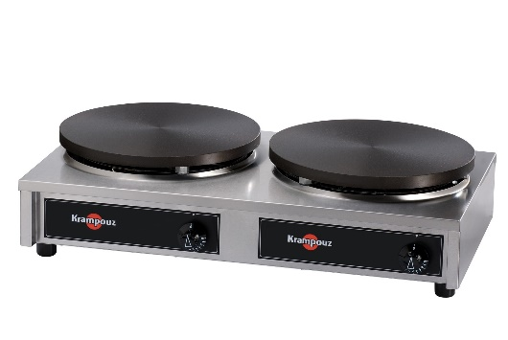
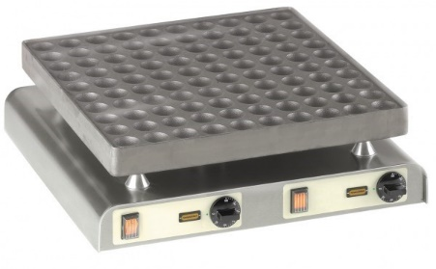
Crepe, Waffle & Pancake
WAFFLE ON STICK MACHINE
WAFFLE BAKER
CREPE MACHINE
PANCAKE MACHINE

Slide 31
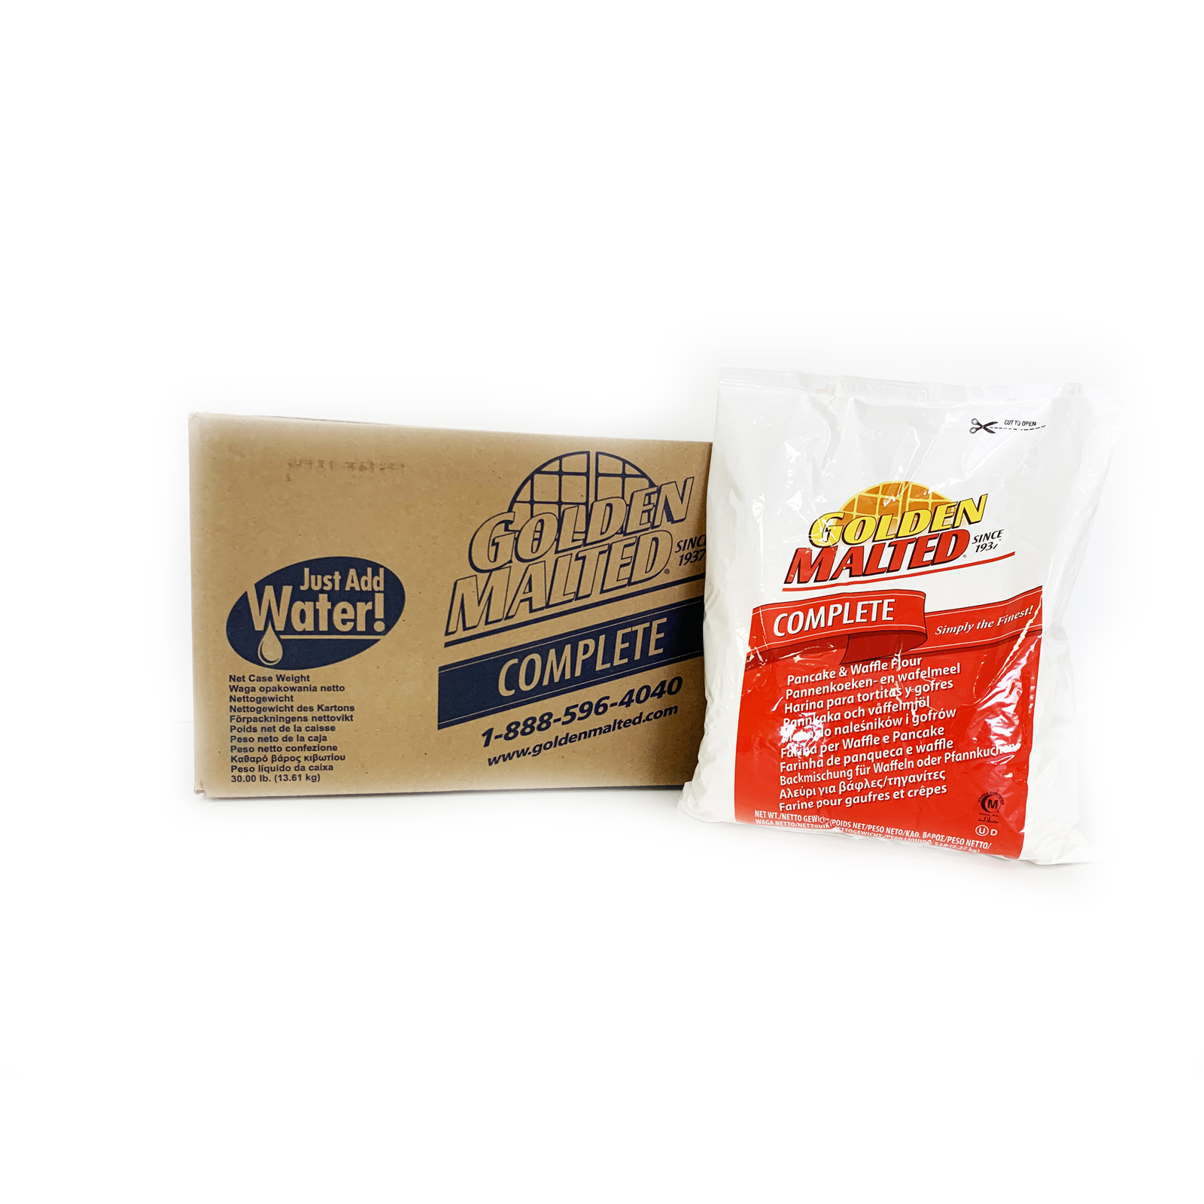
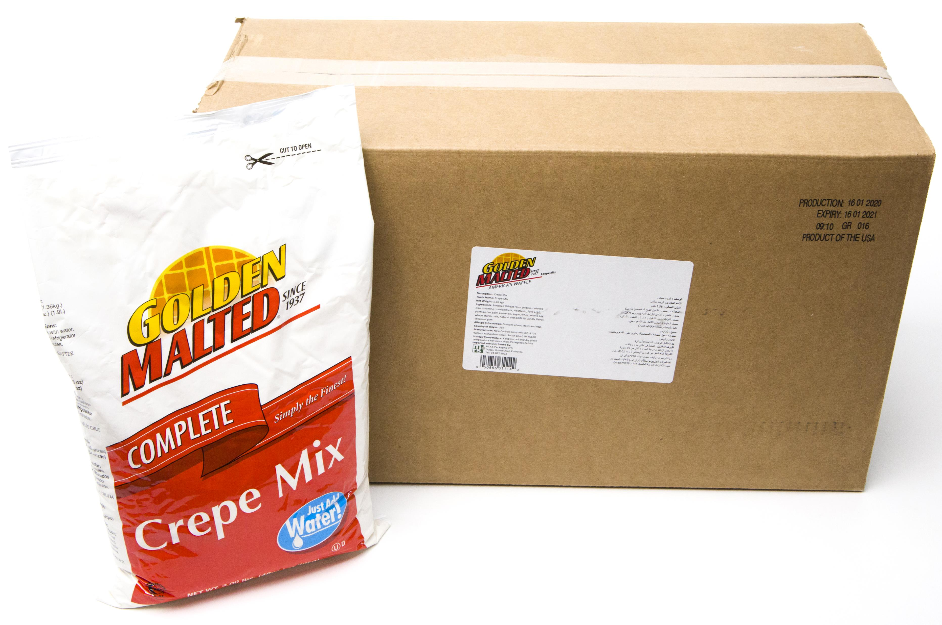
Crepe, Waffle & Pancake Mix
Waffle & Pancake Mix
Crepe Mix

Slide 32
Hot Dog Machines

Slide 33
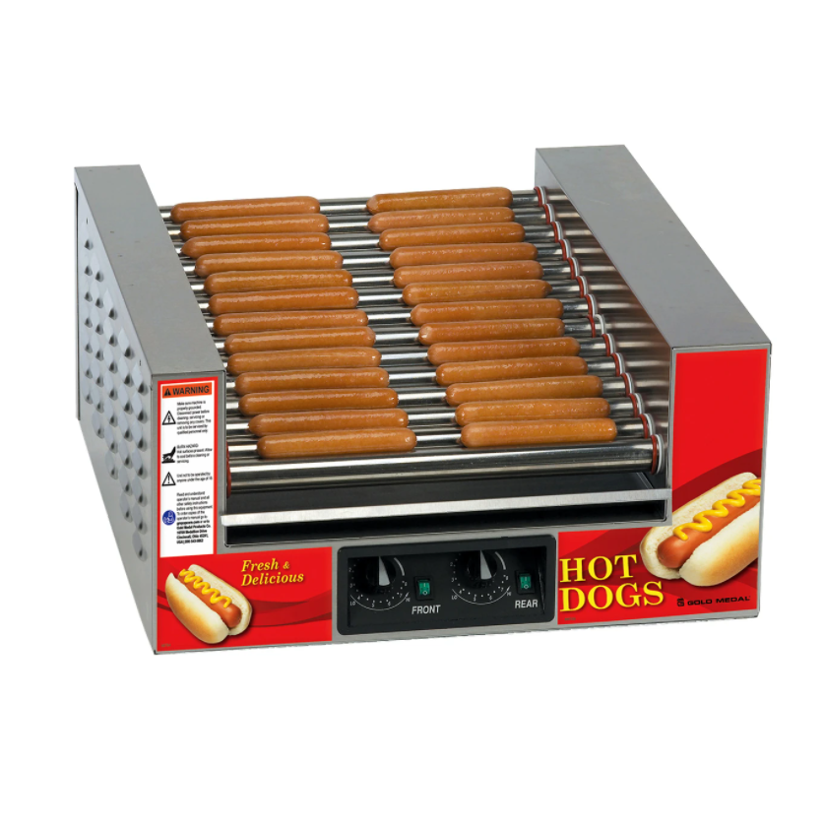
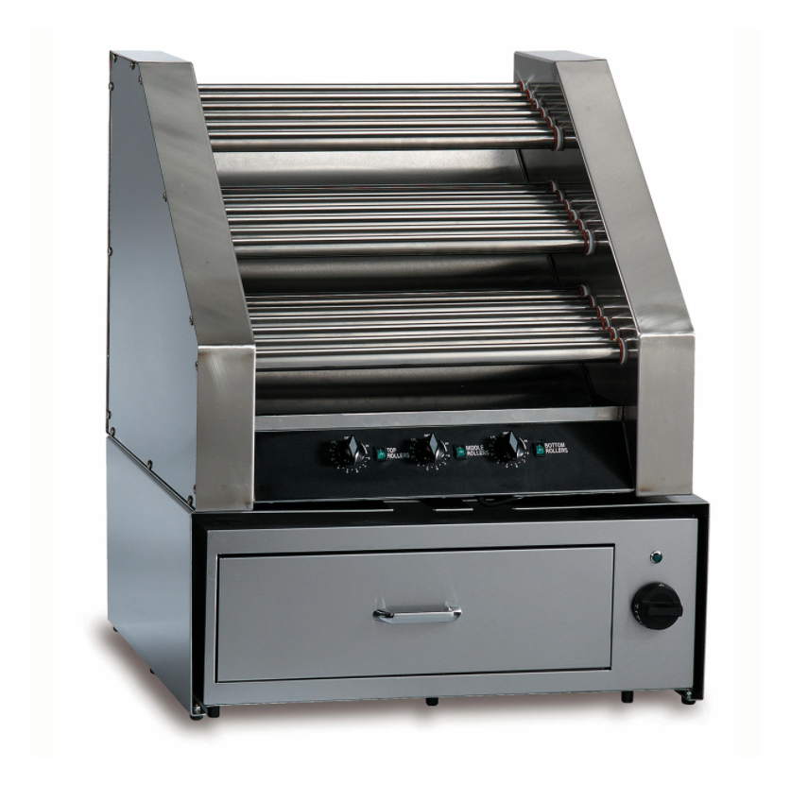
Hotdog Machines
Slanted Hot Diggity® Hot Dog Grill
Three-Tier Hot Dog Grill
Sterno Steamer Cart

Slide 34
M.R.S PACKAGING LIMITED PLOT WB 56&57 DUBAI LOGISTIC CITY DUBAI WORLD CENTRAL, DUBAI SOUTH, JEBEL ALI DUBAI, U.A.E Off Tel: +971-48879823 Email: info@mrspackaging.com Website: www.mrspackaging.com

