Slide 1


Popcorn Presentation

Slide 2

M.R.S. Packaging not only offers name-brand equipment, but also supplies the best quality Fun Food products and disposable packaging. All of our popcorn equipment and supplies are direct from the United States of America.
About Our Business
Your Success is our Success!
After sale, we continue to offer our experienced feedback on concessions set-up and food cost guidance for FREE. Your success is our goal. We continually strive to ensure that our customers are always informed, trained on equipment operation and clean-up, and treated with the utmost care and service.
Concession Equipment
Training for your staff
Supplies
Food cost guidance
Disposable Packaging
Complete free concession business set-up

Slide 3

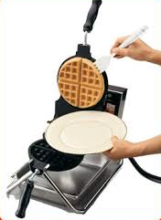
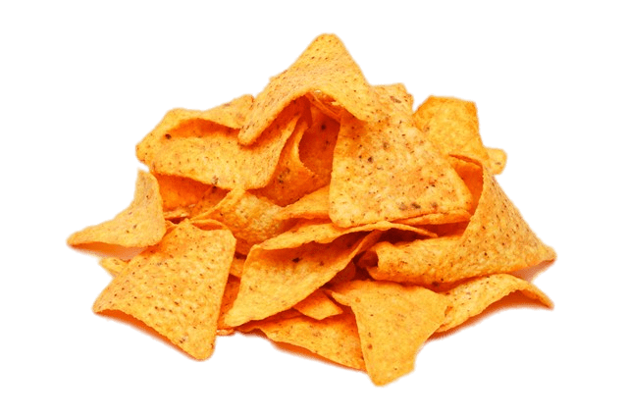

About Us
Easy-to-operate equipment - minimal staff training required
Wide selection of machines
Variety of flavors for every product line
Put a smile on every face
Low food cost = high profit margins!
Right for all kinds of venues including:
Concession Stands
Cinemas
Stadiums
Hotels
Arenas
Candy Stores
Schools
Amusement Parks
Festivals
and more!

Slide 4
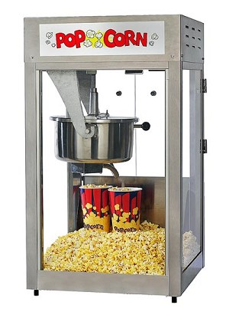
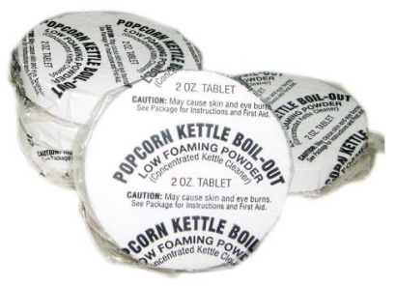
Equipment
Preparation time: approx. 3-4 minutes
16oz Stainless steel E-Z Kleen kettle
20"W x 20"D x 37"H / 82 lbs
Gold Medal Model #2600 Ex
16 Oz Popcorn Machine
Sell 30 tubs per day and reach you ROI in less than two months*!
*Results will vary based on serving size, selling price, etc.
Stainless Steel Kettle
Illuminated Cabin
Gold Medal
Kettle Pucks for Kettle Cleaner
Packing: 1x48
Brand: Gold Medal – U.S.A.
Price: AED 600.00
Recommended investment to keep your kettle sparkling clean!
Heated Deck
(keeps popcorn fresh)
AED 7000

Slide 5
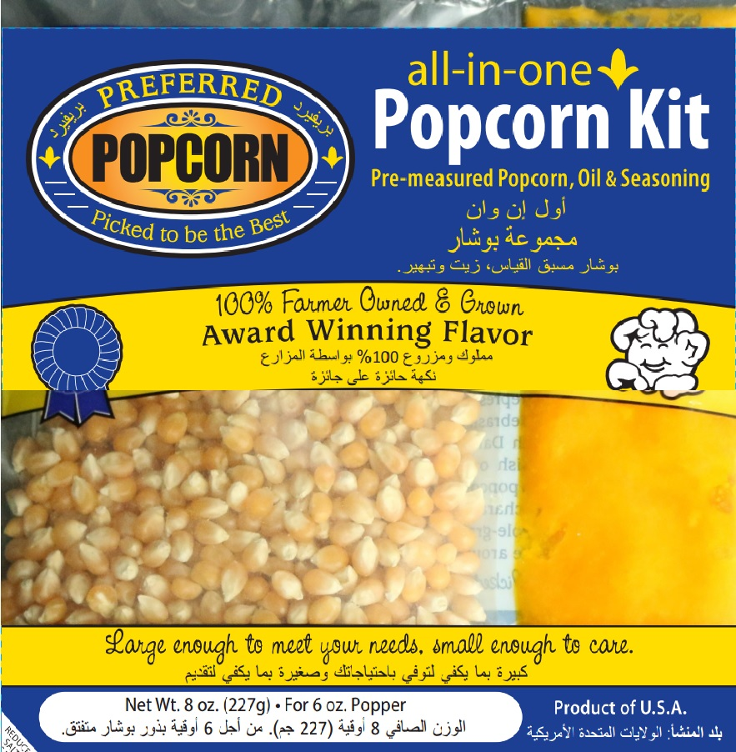
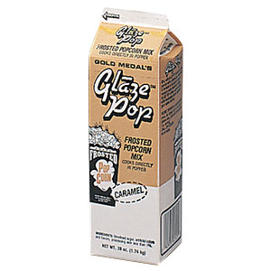
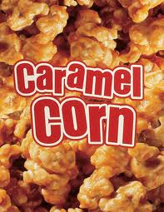
Supplies
[Concentrated Mixes]
Butterfly corn seeds, oil, and butter-flavored salt
Brand: Preferred Popcorn
Pre-portioned packets are easy-to-use and store
One packet yields approximately 8 servings (24 oz)
Preferred
3-in-1 Popcorn Kit
Offer cinema quality popcorn every time!
Add caramel mix with 3-in-1
It’s that simple**!
Caramel Glaze Pop
Added directly to kettle*
=
+
*Use 6 Oz of glaze mix per batch
** Salt from 3-in-1 kit is omitted when preparing caramel corn

Slide 6
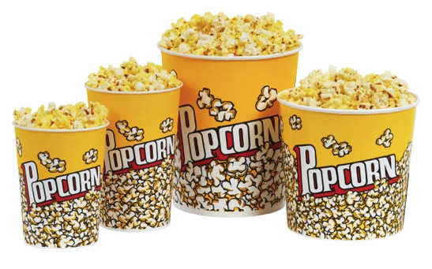
Popcorn Setup – Salted & Caramel
Popular Popcorn Serving Sizes*:
*images for illustration purposes only
Custom printing services available!
We supply all items required to setup your operations!

Slide 7
Popcorn Setup – Salted & Caramel
Served in 24 Oz tubs
Salted
Caramel
*prices subject to change
**serving sizes are approximate

Slide 8
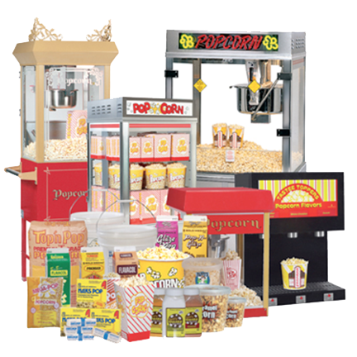
M.R.S. Packaging Ltd
P.O.Box: 17074 | DWC Plot WB56 & WB57 | Dubai Logistic City| DWC | Dubai World Central | Dubai, United Arab Emirates
Telephone: +971 4 887 9823
Manu Soni
Mobile: +971 50 644 7931
Email: msoni@mrspackaging.com
Website: www.mrspackaging.com
Contact M.R.S. Packaging Ltd

