Slide 1
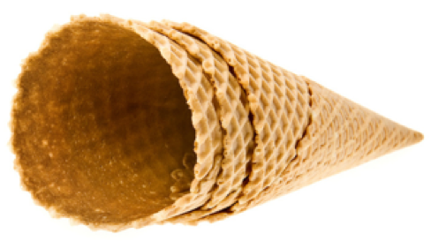
Waffles & Pancake, Waffle Cones and Crepes
Teaming up to offer you a complete program solution!

Slide 2
Carbon’s Golden Malted sells to over 40,000 full-service restaurants, hotels and resorts, colleges and universities and other foodservice establishments around North America through its exclusive distribution network.

Slide 3
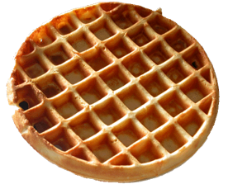
Waffles

Slide 4
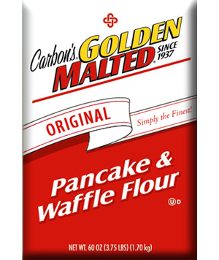
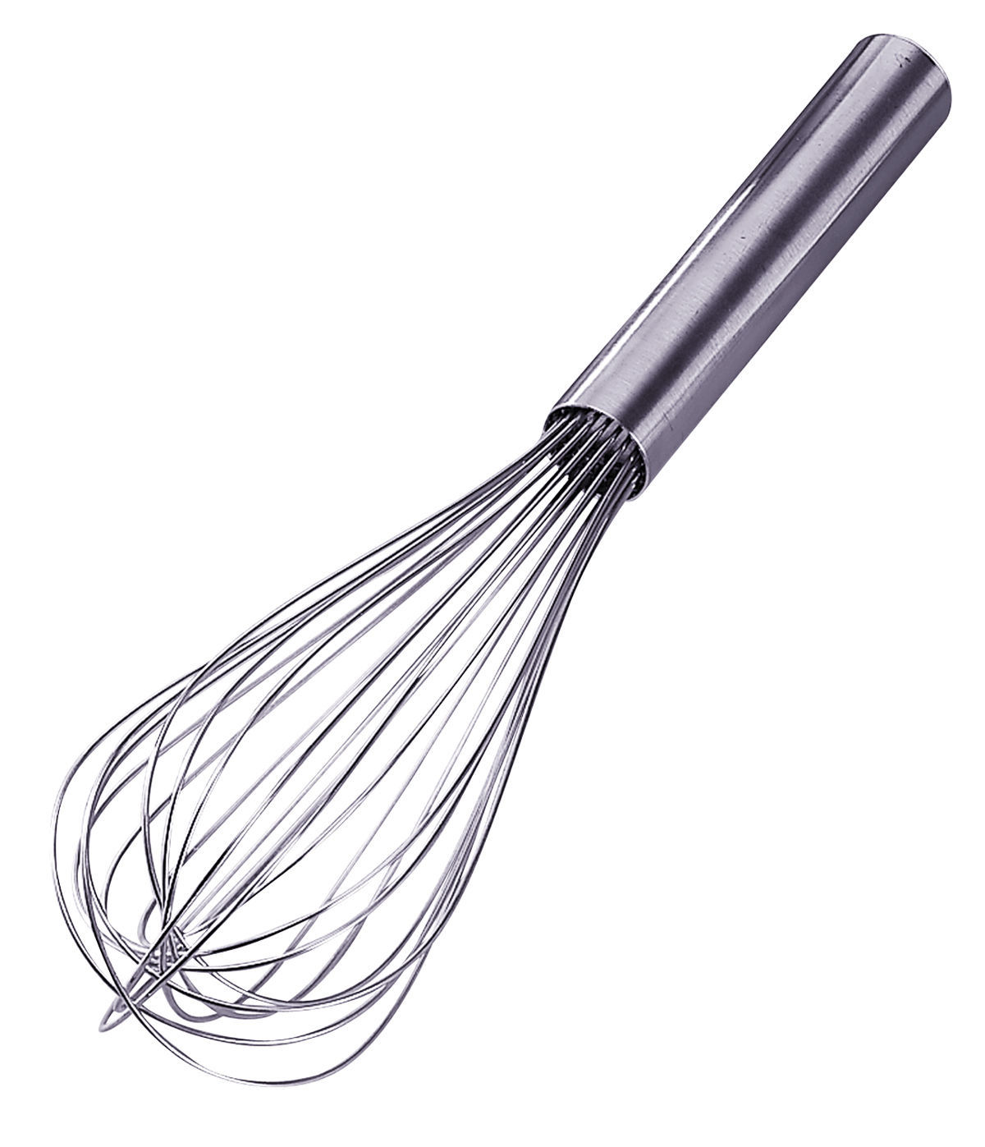
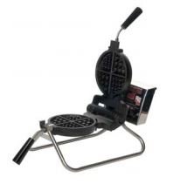
Carbon’s Golden Malted Ready-to-Use Mix
(Just add Water!)
Packing – 6x5 lbs. = 6 bags per case, each bag is 5 lbs.
Total case weight – 30 lbs.
Each bag of mix will yield approximately 30 waffles
Each case of mix will yield approximately 180 waffles
Origin: U.S.A.
Brand: Carbon’s Golden Malted
NON-GMO
Carbon’s Golden Malted Pancake and Waffle Flour – Just Add Water!
WAFFLE
SR. NO. | CODE | PRODUCT DESCRIPTION | PACKING | PRICE | SERVINGS | COST PER SERVING
1 | AWO-NON GMO | Carbon's Non-GMO Add Water Waffle / Pancake Mix | 6 x 5 Lbs. | AED 500.00 | 180 | 2.78

Slide 5
How to Make Waffles
What you will need:
1 (5) lb. Bag of Carbon’s Golden Malted Waffle & Pancake Flour
2.60 Liters of Water
450 – 500 Grams of melted Butter or Whirl
(*Optional – adding butter will make the finished product have a buttery flavor, as well as
more moist in texture)
Instructions:
Add 2.60 liters of water to a mixing bowl
Add 1 bag of Carbon’s Golden Malted Pancake and Waffle Flour
Add 450-500 grams of melted butter or Whirl
Stir with whip till mix is smooth and all clumps have been removed.
Add melted butter or Whirl and whip to mix the butter evenly throughout the batter.
Let batter stand for 15 minutes before use.
Preheat waffle baker.
Season waffle baker grids with 5524 – Seas ‘N Kleen non-stick cooking spray.
Once the baker is heated and ready, pour about 6 oz. of batter onto the lower grid. Let sit for a few seconds, then close the grid and rotate. Set the timer for three minutes, it will sound when the cooking cycle is complete.
Remove with a plastic fork or tongs, DO NOT use metal utensils on the baker as it will damage the non-stick coating.
NON-GMO
Carbon’s Golden Malted Pancake and Waffle Flour – Just Add Water!

Slide 6
Waffle
Cones

Slide 7
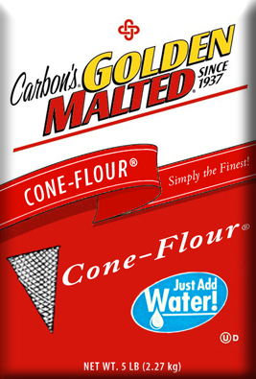
Carbon’s Golden Malted Ready-to-Use Waffle Cone Mix (Just add Water!)
Packing – 6x5 lbs. = 6 bags per case, each bag is 5 lbs.
Total case weight – 30 lbs.
Each bag of mix will yield approximately 75 waffle cones
Each case of mix will yield approximately 450 waffle cones
Origin: U.S.A.
Brand: Carbon’s Golden Malted
NON-GMO
Carbon’s Golden Malted Waffle Cone Flour –
Just Add Water!
CONE
SR. NO. | CODE | PRODUCT DESCRIPTION | PACKING | PRICE | SERVINGS | COST PER SERVING
1 | AWO-NON GMO | Carbon's Non-GMO Add Water Waffle / Pancake Mix | 6 x 5 Lbs. | AED 500.00 | 450 | AED 1.11

Slide 8
How to Make Waffle Cones
What you will need:
Full batch:
5 lbs. Carbon’s Golden Malted Waffle Cone Flour
45 oz. cold water
Half batch:
16 oz. Carbon’s Golden Malted Waffle Cone Flour
9-9.5 oz. water
To prepare:
Add 5 lbs. dry mix to 45 oz. of cold water in a large mixing bowl. (For a half batch, use 1 lb. (16 oz.) of dry mix and 9-9.5 oz. water)
Using a wire whip, mix until smooth.
Allow batter to stand for about 5-10 minutes before using.
Ladle batter evenly onto grid surface and close. Set the timer for 2 minutes, wait until the timer sounds and then remove from the baker using a plastic fork.
Place into desired roller kit or mold, form and wait until cooled and set.
.
Cone Baker & Roller Kit
(Supplied FOC)

Slide 9
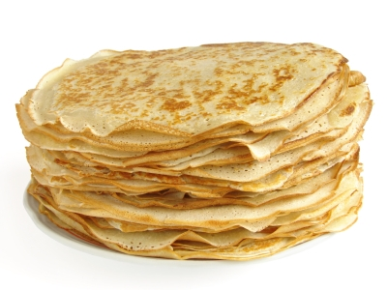
Crepes

Slide 10
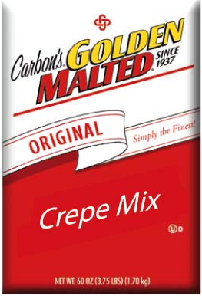
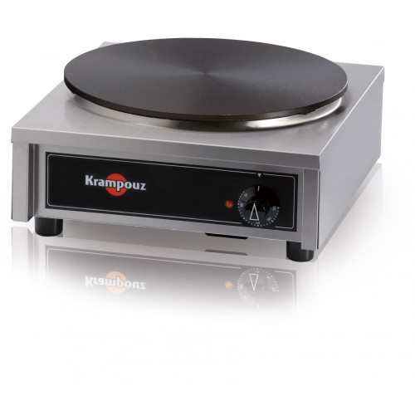
Carbon’s Golden Malted Ready-to-Use
Crepe Mix (Just add Water!)
Packing – 3x10 lbs. = 10 bags per case, each bag is 3 lbs.
Total case weight – 30 lbs.
Each bag of mix will yield approximately 20 (12”) crepes
Each case of mix will yield approximately 200 (12”) crepes
Origin: U.S.A.
Brand: Carbon’s Golden Malted
Light, fresh & delicious!
Easy to prepare, only add water!
Ideal for sweet or savory dishes
Zero Trans Fat
Non-GMO
CREPE
SR. NO. | CODE | PRODUCT DESCRIPTION | PACKING | PRICE | SERVINGS | COST PER SERVING
1 | AWO CREPE MIX | Crepe Mix | 10 x 3 Lbs. | AED 500.00 | 200 | AED 2.50
Carbon’s Golden Malted Crepe Mix - Just add water!

Slide 11
How to Make Crepes
What you will need:
1 (3 lb.) bag of Carbon’s Golden Malted Crepe Mix
(1.7 liters) of water
To prepare:
Add 4 cups (approximately 1 liter) of water to a mixing bowl (half the recommended amount)
Add Carbon’s Golden Malted Crepe mix (3 lb.)
Mix thoroughly until batter is smooth – about 2 minutes
Add remaining water (approximately 700 ml) of water
Mix again until batter is even
Carbon’s Golden Malted Crepe Mix - Just add water!

Slide 12
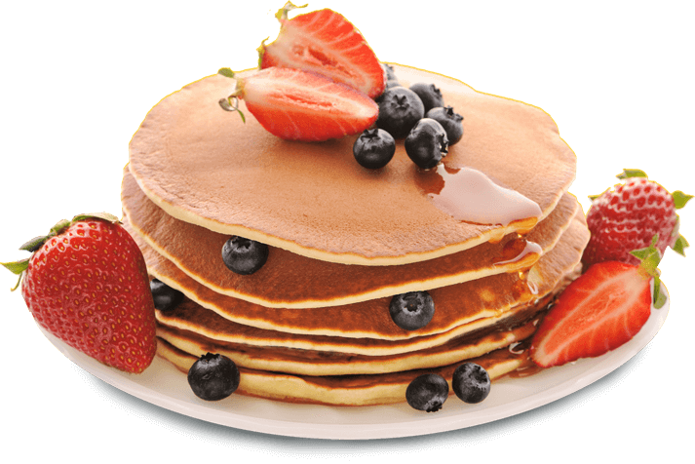
Pancake

Slide 13
Light, fresh & delicious!
Easy to prepare, only add water!
Ideal for sweet or savory dishes
Zero Trans Fat
Non GMO
Carbon’s Golden Malted Ready-to-Use Mix (Just add Water!)
• Packing – 6 x 5 lbs. = 6 bags per case, each bag is 5 lbs. • Total case weight – 30 lbs. • Each bag of mix will yield approximately 60 Pancakes • Each case of mix will yield approximately 360 Pancakes • Origin: U.S.A. • Brand: Carbon’s Golden Malted
Carbon’s Golden Malted Ready-to-Use Mix (Just add Water!)
PANCAKE
SR. NO. | CODE | PRODUCT DESCRIPTION | PACKING | PRICE | SERVINGS | COST PER SERVING
1 | AWO-NON GMO | Carbon's Non-GMO Add Water Waffle / Pancake Mix | 6 x 5 Lbs. | AED 500.00 | 360 | AED 1.25

Slide 14
How to Make Pancakes
What you will need:
1(5 Lb) Bag of Carbon’s Golden Malted Waffle & Pancake Flour
500 ml of Water
2 Liter of Milk
500 Grams Butter or Whirl (*Optional – adding butter will
make the finished product have a more buttery flavor, and a more
moist texture)
Instructions:
Add 1 Bag (5 Lb) Mix to Water 500 ml & 2 Liters of milk to a large mixing bowl.
Stir with whip until the mix is smooth and all of the clumps have been removed.
Add the melted butter 500 grams and whip to mix evenly throughout the batter.
Let batter stand for 15 minutes before use.
Pour desired amount of batter onto a pre-heated griddle.
Wait until bubbles begin to form on the top and the edges are just slightly brown.
Using a spatula, lift and flip the pancake to cook the other side for about 1-2 minutes more.
Remove from the griddle using a spatula, serve as desired.
Carbon’s Golden Malted Crepe Mix - Just add water!

Slide 15
Contact Us
M.R.S. Packaging Ltd P.O. Box: 17074 | DWC Plot WB56 & WB57 | Dubai Logistic City | Dubai World Central | Dubai, United Arab Emirates | Tel: +971 4 887 9823 | Fax: +971 4 887 9358 E-mail: msoni@mrspackaging.com | Website: www.mrspackaging.com

